Slide 1
GitHub to AWS, Step by Step
GitHub
IMS Root
Target account
Every step-through flow, updated on 3 November 2026 for the new CloudFormation pipeline
19 flows · 108 steps · click or press → to move through each flow

Slide 2




What’s new in the CloudFormation pipeline
WHAT’S NEW · 3 NOVEMBER 2026
Four changes to the new pipeline. Each card links to the slides in Part 2 that explain it step by step.
47 accounts, picked by name
Hop 1 and hop 2, shown and checked
Infrastructure, Security, Sandbox, Root-IMS and Workload accounts, as <OU>-<ENV>-<Account>. Before: three network accounts.
After each hop, every box prints the role AWS gave it and stops if it is the wrong one. The summary shows both.
See slide 29 →
See slide 32 →
Root-IMS in one hop
A guard for manual changes
Stacks in IMS Root itself sign in once, with the scoped iamr-plat-prd-deploy role. No second hop.
With Deploy = yes, a change set that would undo manual changes runs only when Remove manual changes = yes.
See slide 31 →
See slide 36 →
STILL THE SAME Drift check for information only · drift-aware change set · S3 for templates over 51,200 bytes · one run per stack at a time · the old pipeline and the WS2 DNS pipelines

Slide 3
How the Pipeline Gets Into AWS
1
PART 1 OF 4
New pipeline · Old pipeline
Picture key: signed note = GitHub’s OIDC token · reception copy = the iamr role in IMS Root · master key = AWSControlTowerExecution

Slide 4
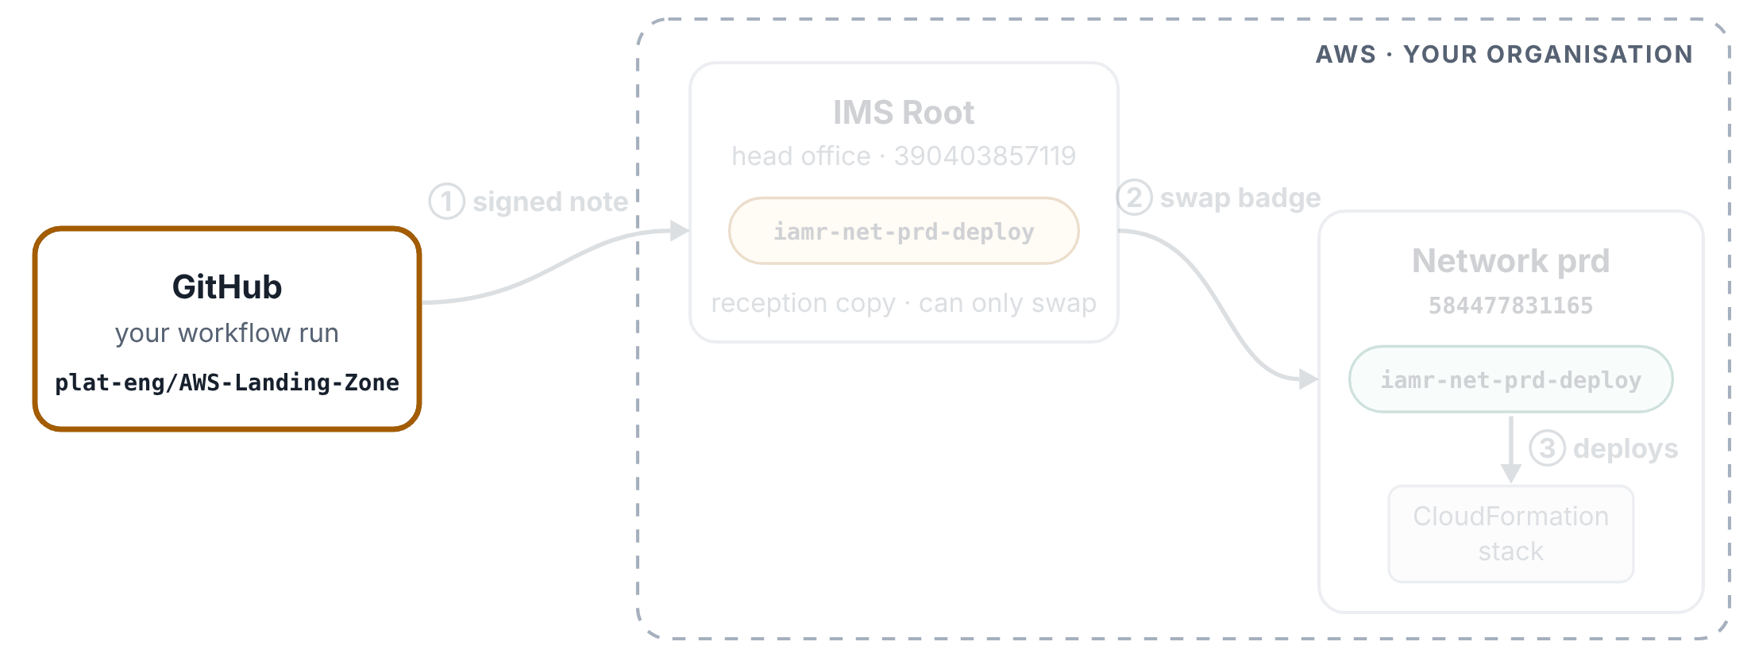
New pipeline: one run
HOW THE PIPELINE GETS INTO AWS
Step 1 of 7
A run of the converted CloudFormation pipeline for Infrastructure-PRD-NetworkServices, signing in through IMS Root.
You start the run
On the Actions tab you choose Run workflow and pick Infrastructure-PRD-NetworkServices from 47 accounts, listed by friendly name. Nothing has touched AWS yet.

Slide 5
New pipeline: one run
HOW THE PIPELINE GETS INTO AWS
Step 2 of 7
A run of the converted CloudFormation pipeline for Infrastructure-PRD-NetworkServices, signing in through IMS Root.
The pipeline works out the badge
The Pick the roles step looks the name up in a table in the file: badge iamr-net-prd-deploy, account 584477831165. The badge has the same name in IMS Root and in the account. No GitHub secret is involved.

Slide 6
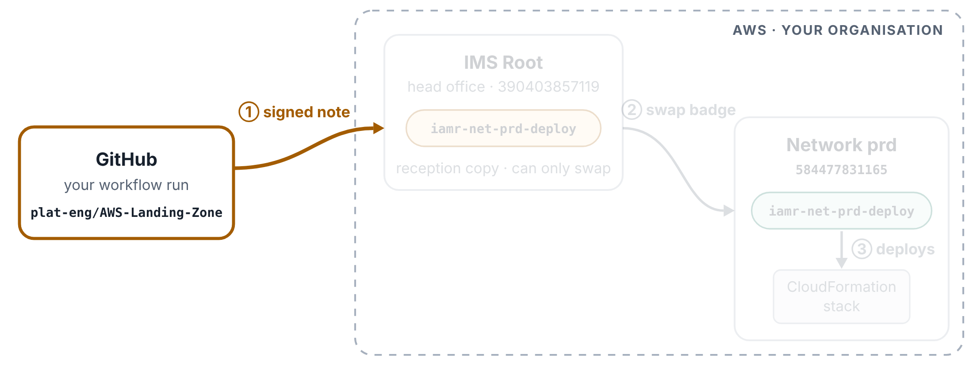
New pipeline: one run
HOW THE PIPELINE GETS INTO AWS
Step 3 of 7
A run of the converted CloudFormation pipeline for Infrastructure-PRD-NetworkServices, signing in through IMS Root.
GitHub writes a signed note
The Sign in to IMS Root step first asks GitHub for a short note about this run, and GitHub signs it so AWS can tell it is genuine. This is what OIDC means. The line id-token: write at the top of the file allows the run to ask for the note.

Slide 7
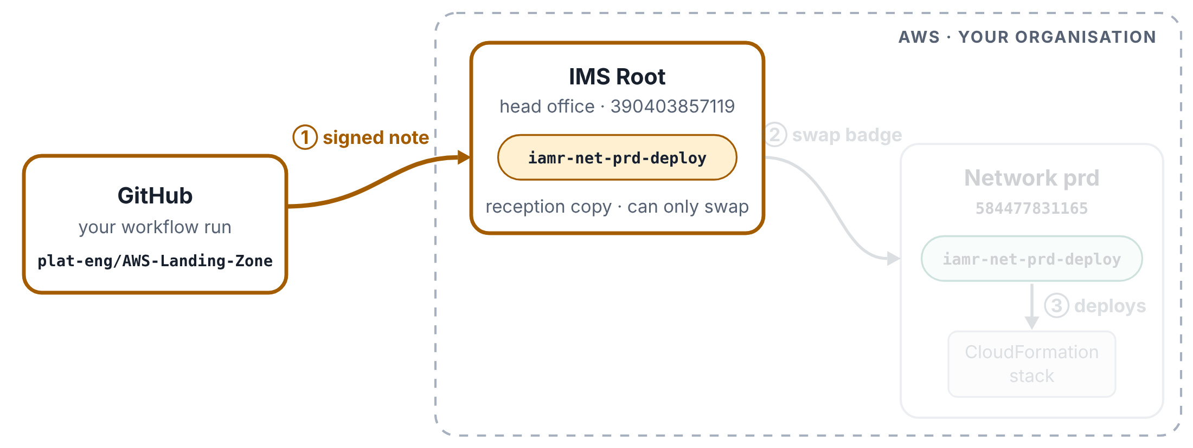
New pipeline: one run
HOW THE PIPELINE GETS INTO AWS
Step 4 of 7
A run of the converted CloudFormation pipeline for Infrastructure-PRD-NetworkServices, signing in through IMS Root.
Hop 1: check in at IMS Root
The same step hands the note to AWS and asks for the reception copy of the badge, in IMS Root. AWS reads that badge’s door list: the note must come from your GitHub, and from AWS-Landing-Zone or ims-app-identity. It does, so the run gets the reception badge for one hour. The next step prints it as 🔐 Hop 1 and checks it.

Slide 8
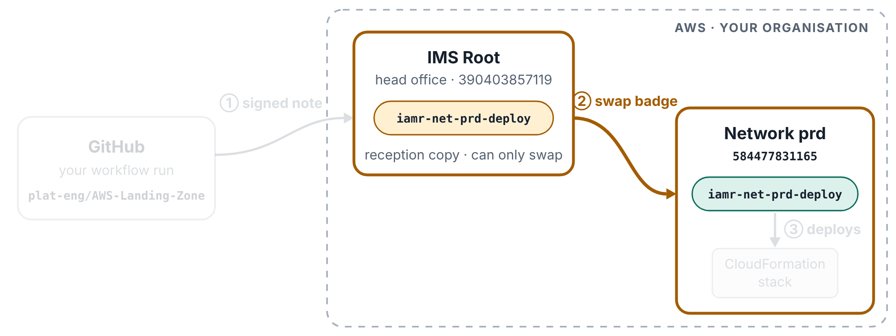
New pipeline: one run
HOW THE PIPELINE GETS INTO AWS
Step 5 of 7
A run of the converted CloudFormation pipeline for Infrastructure-PRD-NetworkServices, signing in through IMS Root.
Hop 2: swap it for the network badge
The Switch to the deploy role step hands in the reception badge and asks for iamr-net-prd-deploy in network prd. AWS checks that the reception badge may make exactly this swap, and that the network badge’s door list accepts it. The run now holds the network badge for one hour, printed and checked as 🔐 Hop 2.

Slide 9
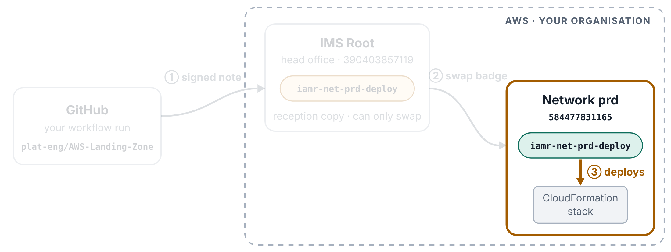
New pipeline: one run
HOW THE PIPELINE GETS INTO AWS
Step 6 of 7
A run of the converted CloudFormation pipeline for Infrastructure-PRD-NetworkServices, signing in through IMS Root.
The work happens in network prd
Every AWS command after this (drift check, change set, deploy) runs as iamr-net-prd-deploy in 584477831165, and Control Tower’s safety rules apply to it.

Slide 10
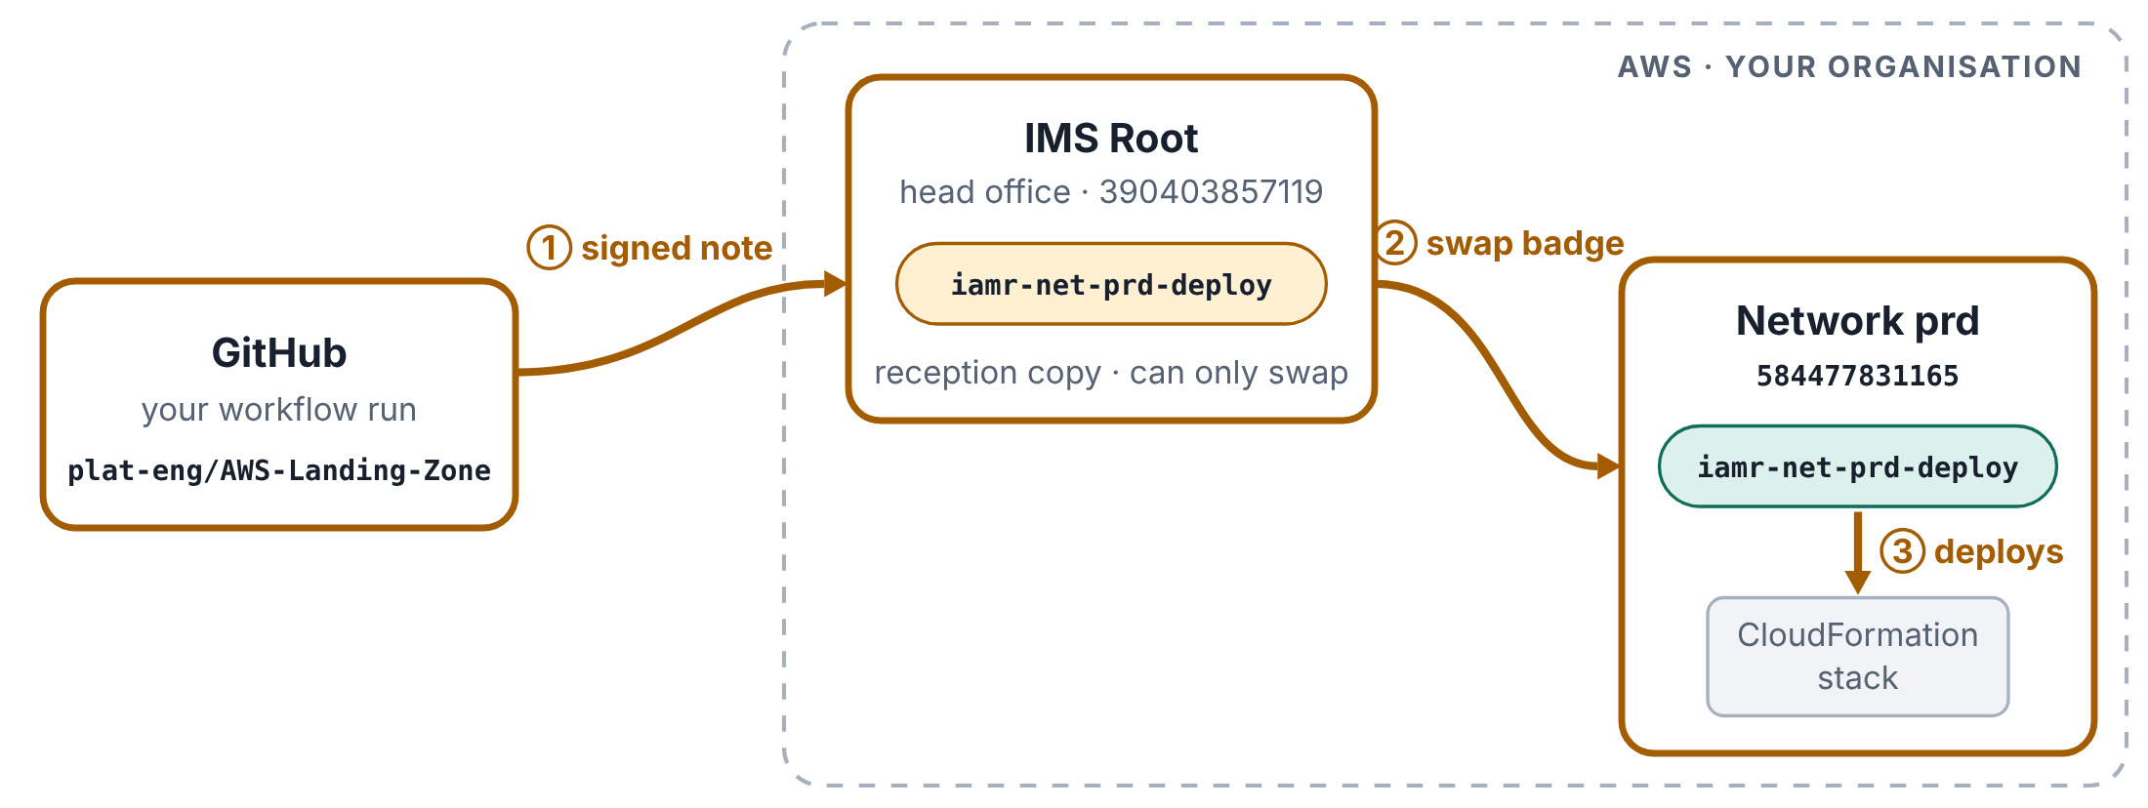
New pipeline: one run
HOW THE PIPELINE GETS INTO AWS
Step 7 of 7
A run of the converted CloudFormation pipeline for Infrastructure-PRD-NetworkServices, signing in through IMS Root.
Each box on the run page repeats both hops
Each box (Prepare, Drift check, Change set, Deploy) starts on a fresh computer, so each one checks in at IMS Root, swaps again and prints both badges. After an hour the badges stop working on their own, and no account badge is kept in a GitHub secret.

Slide 11
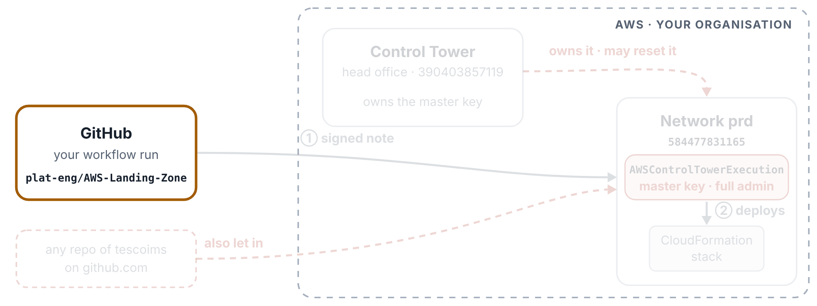
Old pipeline: one run
HOW THE PIPELINE GETS INTO AWS
Step 1 of 6
The same run in the old pipeline, signing in with Control Tower’s master key.
You start the run
You choose Run workflow and pick NETWORK from 18 accounts. Nothing has touched AWS yet.

Slide 12
Old pipeline: one run
HOW THE PIPELINE GETS INTO AWS
Step 2 of 6
The same run in the old pipeline, signing in with Control Tower’s master key.
The pipeline looks up a secret
NETWORK maps to the name of a GitHub secret, NETWORK_SERVICES_ROLE. The value inside that secret is arn:aws:iam::584477831165:role/AWSControlTowerExecution.

Slide 13
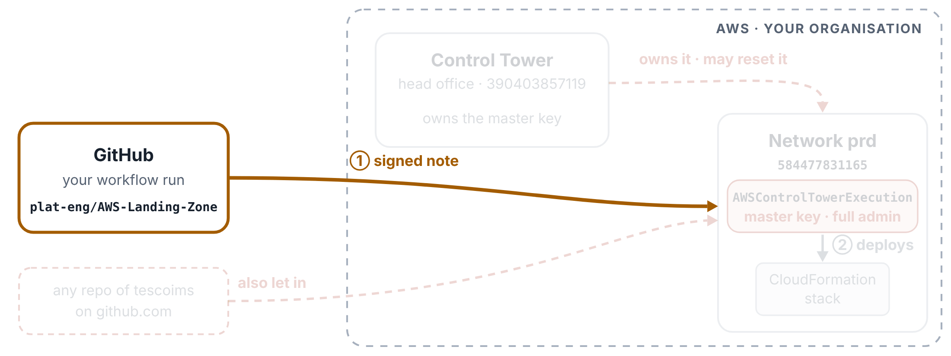
Old pipeline: one run
HOW THE PIPELINE GETS INTO AWS
Step 3 of 6
The same run in the old pipeline, signing in with Control Tower’s master key.
GitHub writes a signed note
Same as the new pipeline: the run asks GitHub for a signed note saying which repo and branch it comes from.

Slide 14
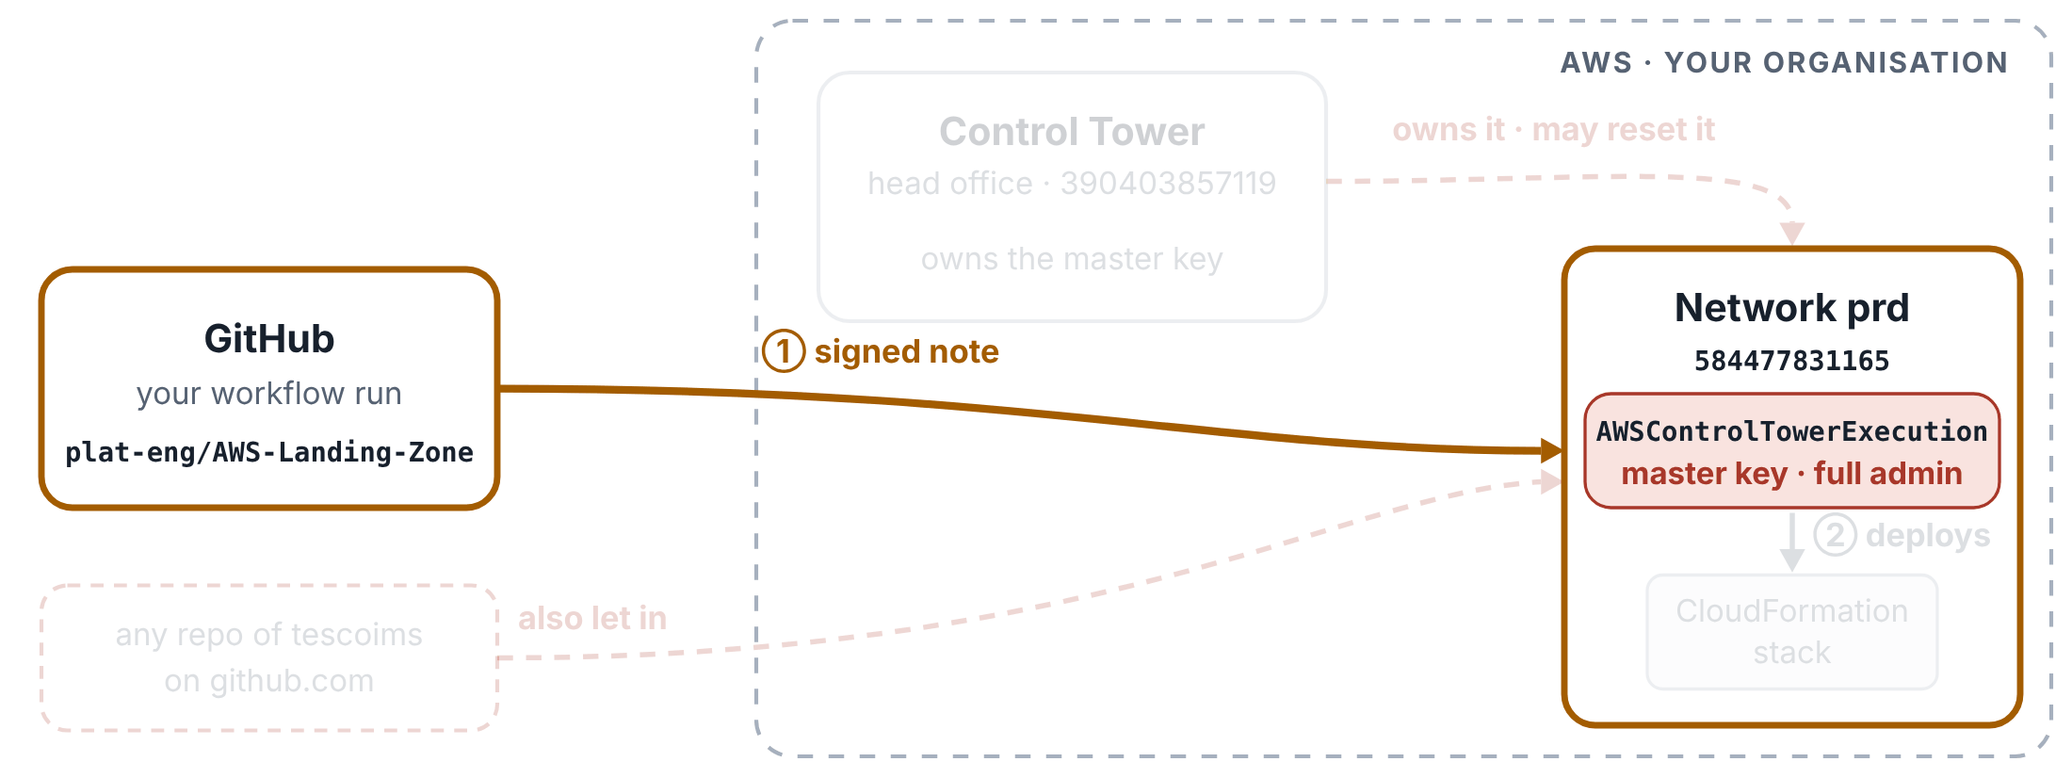
Old pipeline: one run
HOW THE PIPELINE GETS INTO AWS
Step 4 of 6
The same run in the old pipeline, signing in with Control Tower’s master key.
One hop, straight to the master key
The Configure AWS credentials step hands the note to AWS and asks for AWSControlTowerExecution in network prd. Someone added your repo to that key’s door list, so AWS says yes.

Slide 15
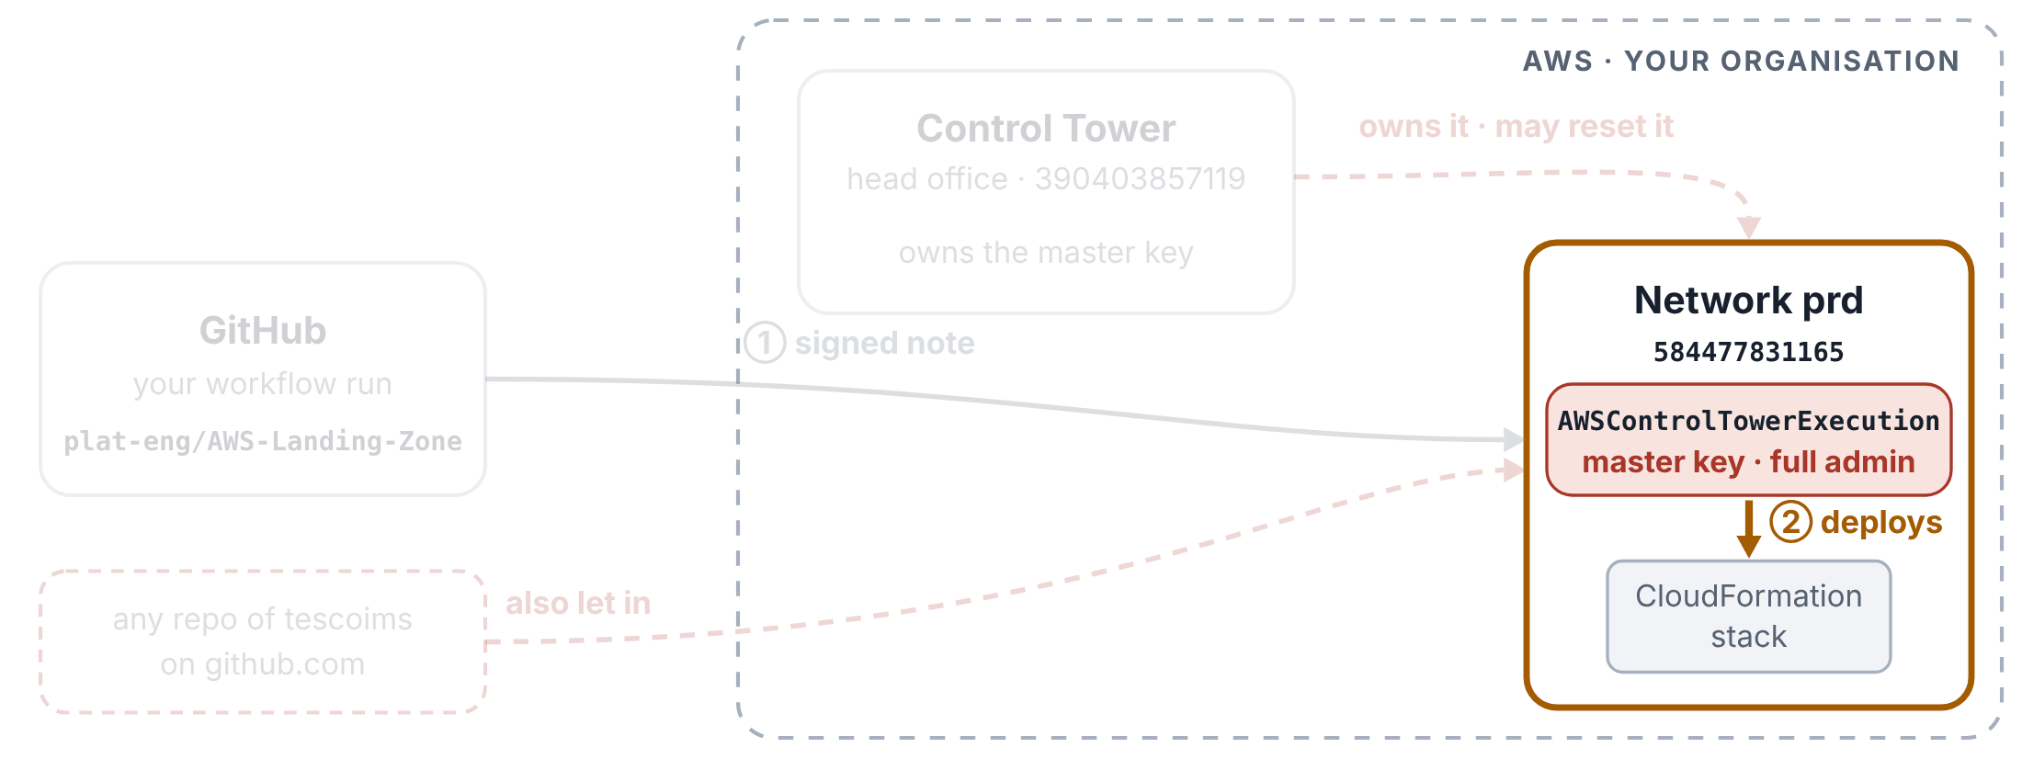
Old pipeline: one run
HOW THE PIPELINE GETS INTO AWS
Step 5 of 6
The same run in the old pipeline, signing in with Control Tower’s master key.
The work runs with the master key
Every AWS command runs as Control Tower’s own master key: it can do everything, and Control Tower’s safety rules make an exception for it.

Slide 16
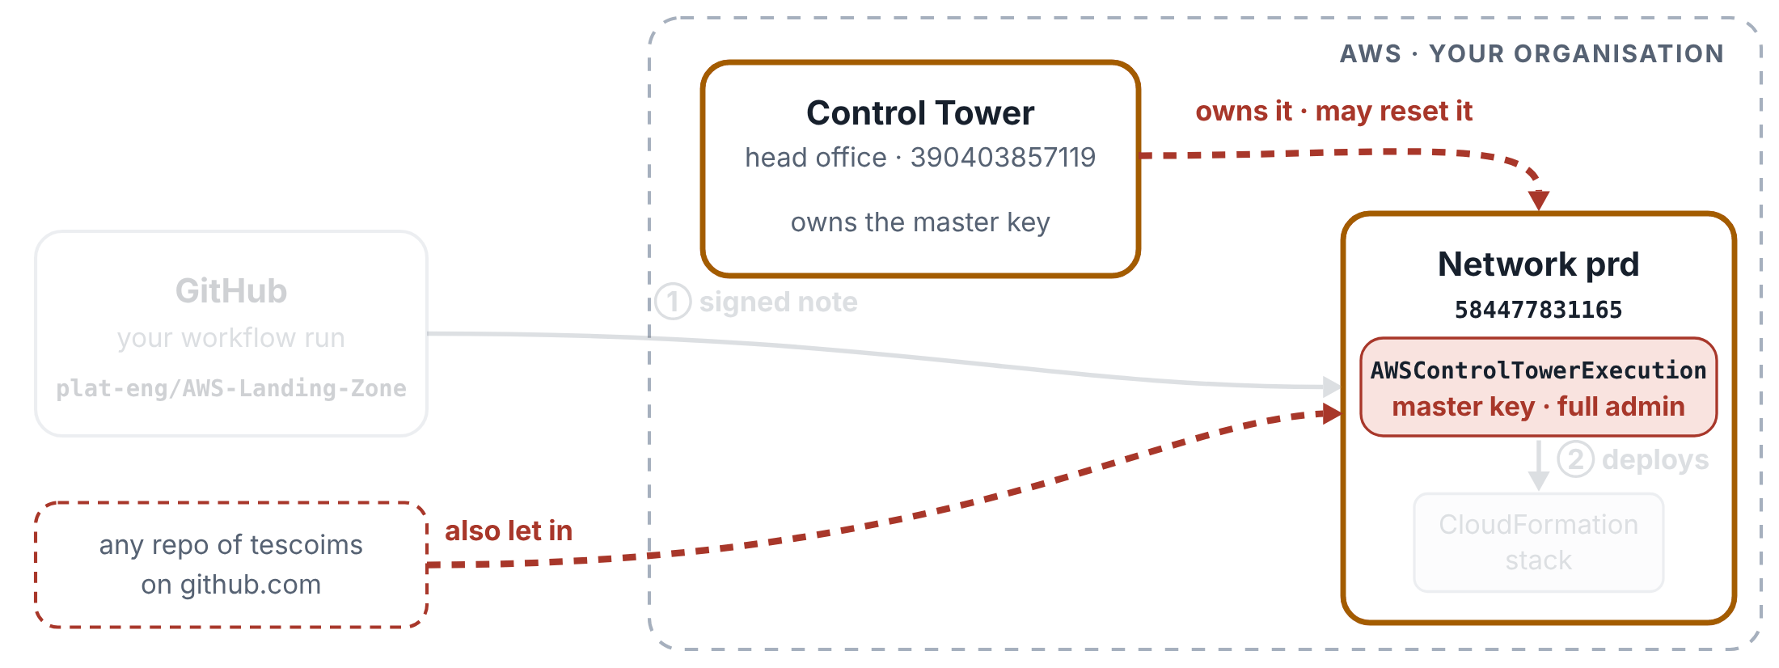
Old pipeline: one run
HOW THE PIPELINE GETS INTO AWS
Step 6 of 6
The same run in the old pipeline, signing in with Control Tower’s master key.
Why the client wants it gone
Control Tower owns this key and can rewrite its door list when the landing zone is updated, which would break the pipeline without warning. The door list also lets in any repo of the tescoims organisation on github.com, from any branch.

Slide 17
Your New Pipelines Explained
2
PART 2 OF 4
CloudFormation pipeline · New: 47 accounts, both hops checked, manual changes · The pipeline on screen · Trust store pipeline: a manual run and a pull request check
Both pipelines sign in the new way: IMS Root first, then the target account.

Slide 18
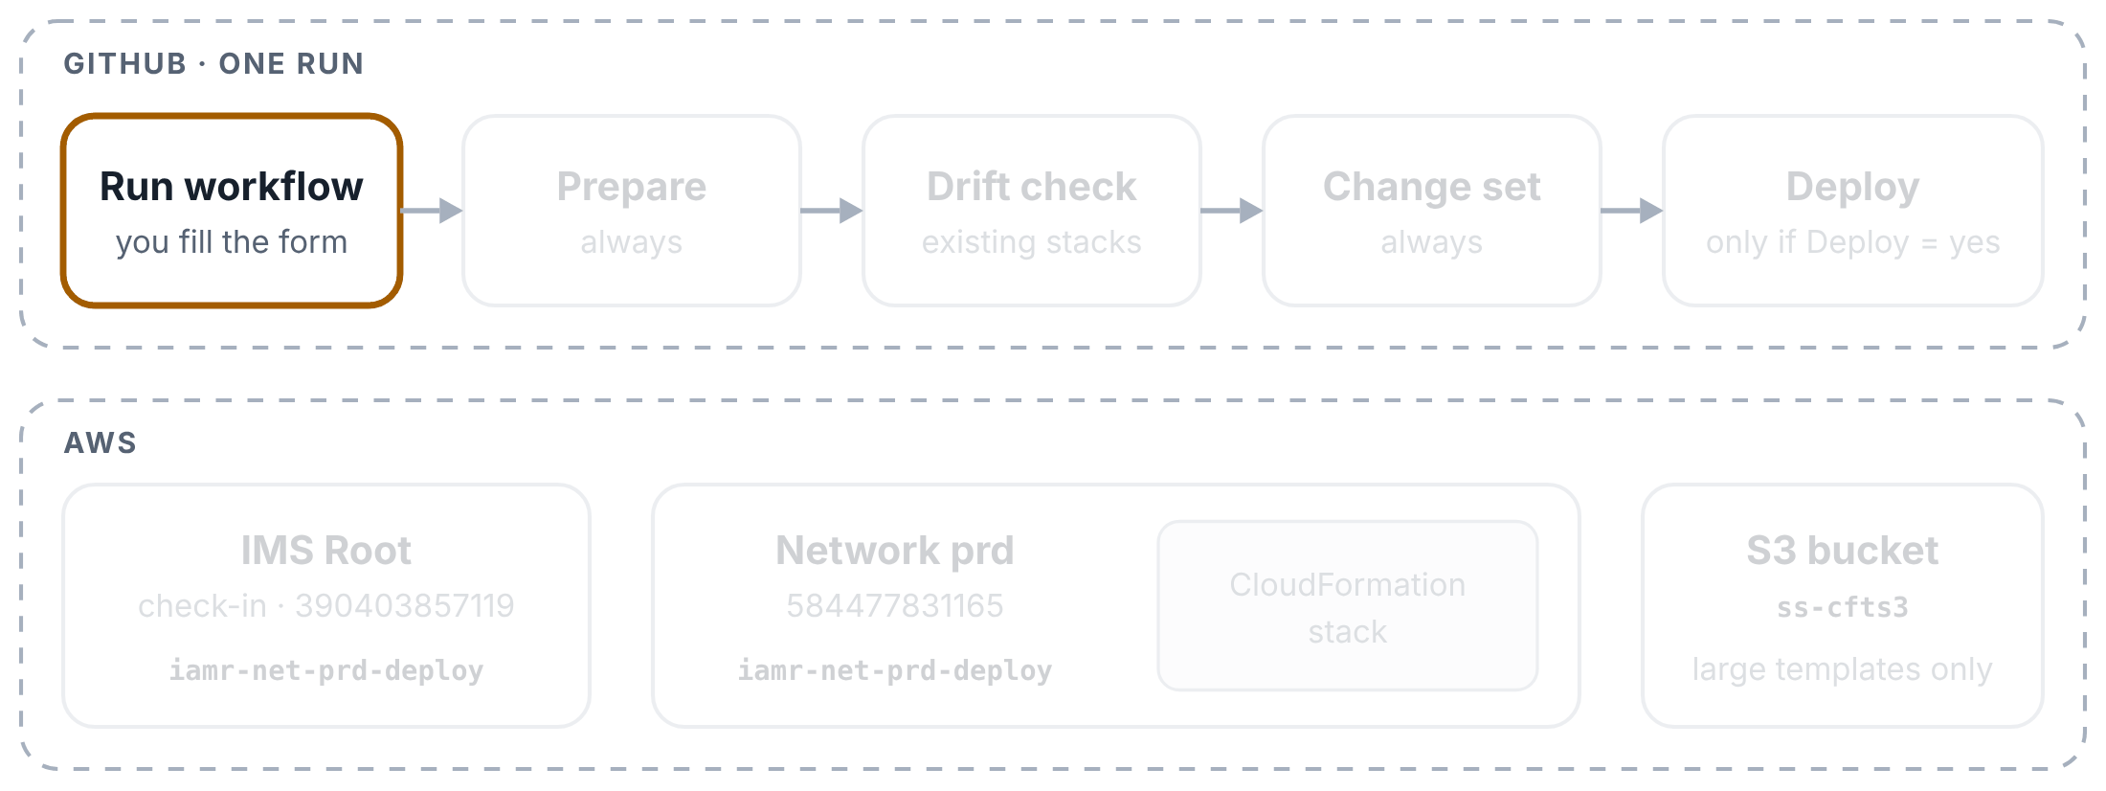
CloudFormation pipeline: one run
YOUR NEW PIPELINES EXPLAINED
Step 1 of 11
One run for Infrastructure-PRD-NetworkServices (network prd). Top row: the boxes on the run page. Bottom row: what each box touches in AWS.
You start the run
In the repo’s Actions tab, pick CloudFormation Stack using S3 as required, click Run workflow and fill in the form: the folder, the stack name, the Account (one of 47 friendly names), the Region, and Deploy and Remove manual changes (both no unless you change them). The run’s title is made from your answers: 🚀 or 📝, then stack · account · Region.

Slide 19
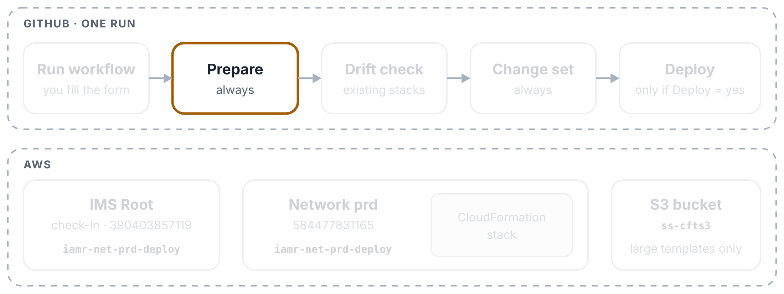
CloudFormation pipeline: one run
YOUR NEW PIPELINES EXPLAINED
Step 2 of 11
One run for Infrastructure-PRD-NetworkServices (network prd). Top row: the boxes on the run page. Bottom row: what each box touches in AWS.
Prepare works out the roles
The first box starts on a fresh GitHub computer and copies your repo. It looks the account up in a table in the file: account number and role name. That gives two roles with the same name, one in IMS Root and one in the network account. No secret is involved.

Slide 20
CloudFormation pipeline: one run
YOUR NEW PIPELINES EXPLAINED
Step 3 of 11
One run for Infrastructure-PRD-NetworkServices (network prd). Top row: the boxes on the run page. Bottom row: what each box touches in AWS.
Prepare finds your files
It looks in cloudformation/<folder>/ for the template and params.json, and checks the stack name. A template over 51,200 bytes will go through S3 later.

Slide 21
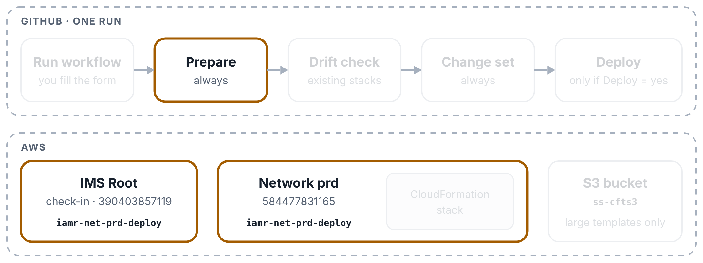
CloudFormation pipeline: one run
YOUR NEW PIPELINES EXPLAINED
Step 4 of 11
One run for Infrastructure-PRD-NetworkServices (network prd). Top row: the boxes on the run page. Bottom row: what each box touches in AWS.
Prepare signs in through IMS Root
Two steps: GitHub’s signed note gets the run into IMS Root (hop 1), then it swaps that role for the deploy role in network prd (hop 2). After each hop the box asks AWS which role it now holds, prints it (🔐 Hop 1, 🔐 Hop 2) and stops if it isn’t the expected one. The keys last an hour.

Slide 22
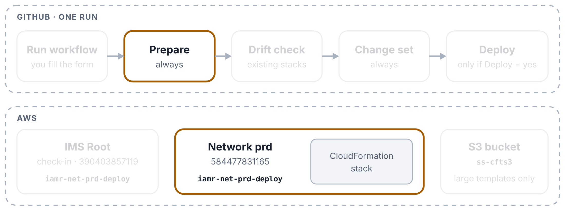
CloudFormation pipeline: one run
YOUR NEW PIPELINES EXPLAINED
Step 5 of 11
One run for Infrastructure-PRD-NetworkServices (network prd). Top row: the boxes on the run page. Bottom row: what each box touches in AWS.
Prepare checks the account and the stack
It makes sure AWS signed it in to the account you picked, then asks CloudFormation about the stack: new → create; existing and settled → drift report, then update; broken or busy → stop with a clear message. The summary shows the account, both hop roles and the plan.

Slide 23
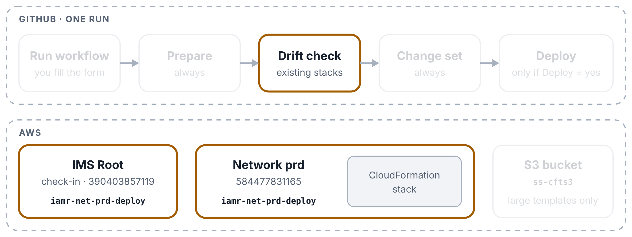
CloudFormation pipeline: one run
YOUR NEW PIPELINES EXPLAINED
Step 6 of 11
One run for Infrastructure-PRD-NetworkServices (network prd). Top row: the boxes on the run page. Bottom row: what each box touches in AWS.
Drift check: information only
The second box signs in again, both hops checked, and asks CloudFormation whether anyone changed the stack’s resources by hand. If so, it lists them as a warning, but the run never stops here: it always carries on to the change set. For a new stack this box is grey.

Slide 24
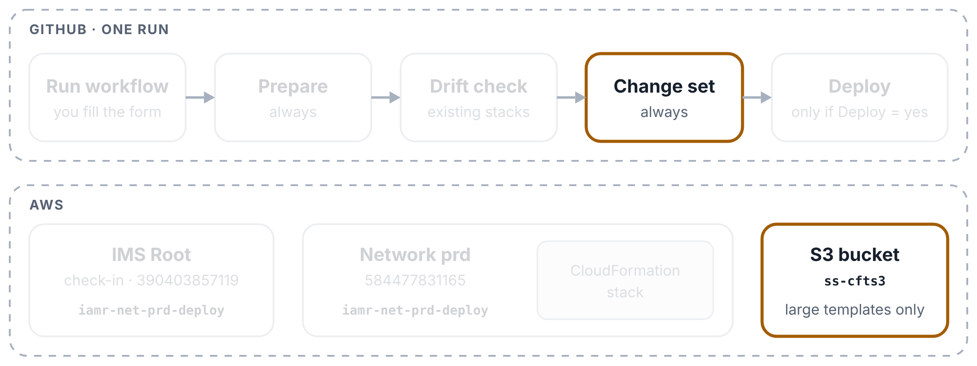
CloudFormation pipeline: one run
YOUR NEW PIPELINES EXPLAINED
Step 7 of 11
One run for Infrastructure-PRD-NetworkServices (network prd). Top row: the boxes on the run page. Bottom row: what each box touches in AWS.
Change set: a large template goes to S3
Only when the template is over 51,200 bytes. The third box signs in with the separate S3 role (still a secret), uploads the template with a short-lived link, and keeps a read link for CloudFormation.

Slide 25
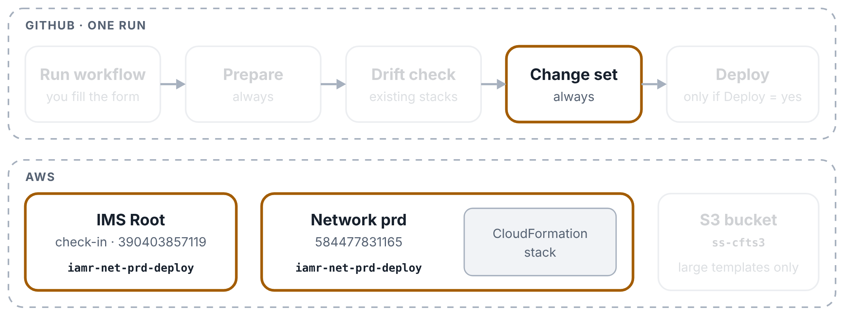
CloudFormation pipeline: one run
YOUR NEW PIPELINES EXPLAINED
Step 8 of 11
One run for Infrastructure-PRD-NetworkServices (network prd). Top row: the boxes on the run page. Bottom row: what each box touches in AWS.
Change set: create it
The box signs in to the network account (both hops checked), checks the template, works out the parameters, and asks CloudFormation for a change set. For an existing stack the change set is drift-aware: it is compared with the live resources, not only the last template. Nothing changes in AWS yet.

Slide 26
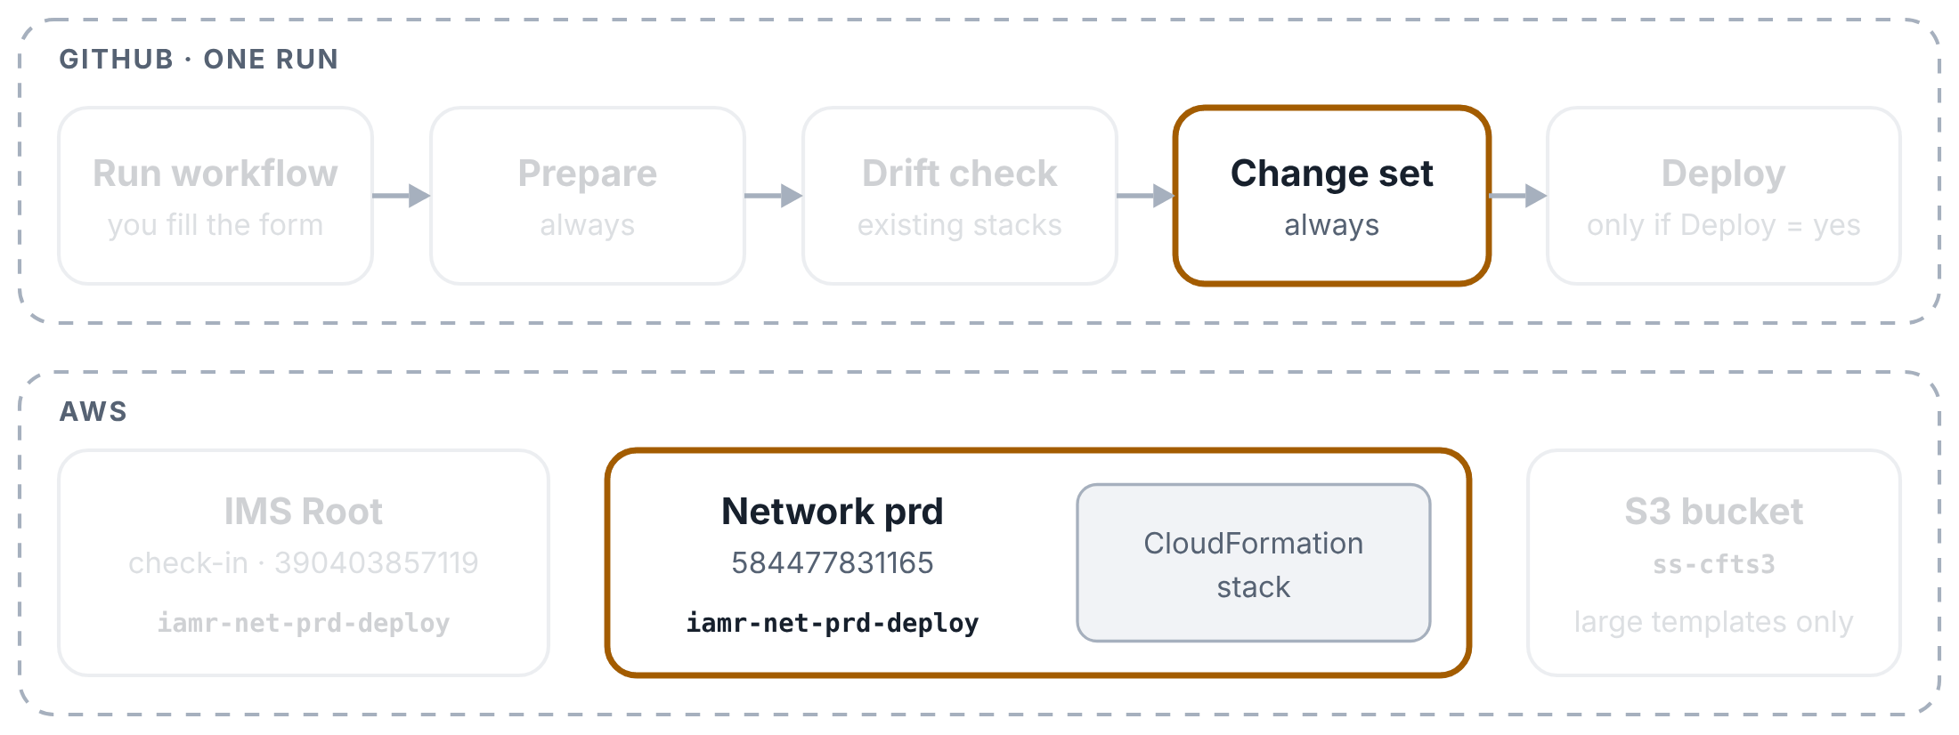
CloudFormation pipeline: one run
YOUR NEW PIPELINES EXPLAINED
Step 9 of 11
One run for Infrastructure-PRD-NetworkServices (network prd). Top row: the boxes on the run page. Bottom row: what each box touches in AWS.
Change set: what will change
The log lists the manual changes that executing would remove (put back to the template), then the template changes it would apply, before → after, with warnings for replacements and removals. With Deploy = no the run ends here: review the change set from the summary’s console link and execute it yourself.

Slide 27
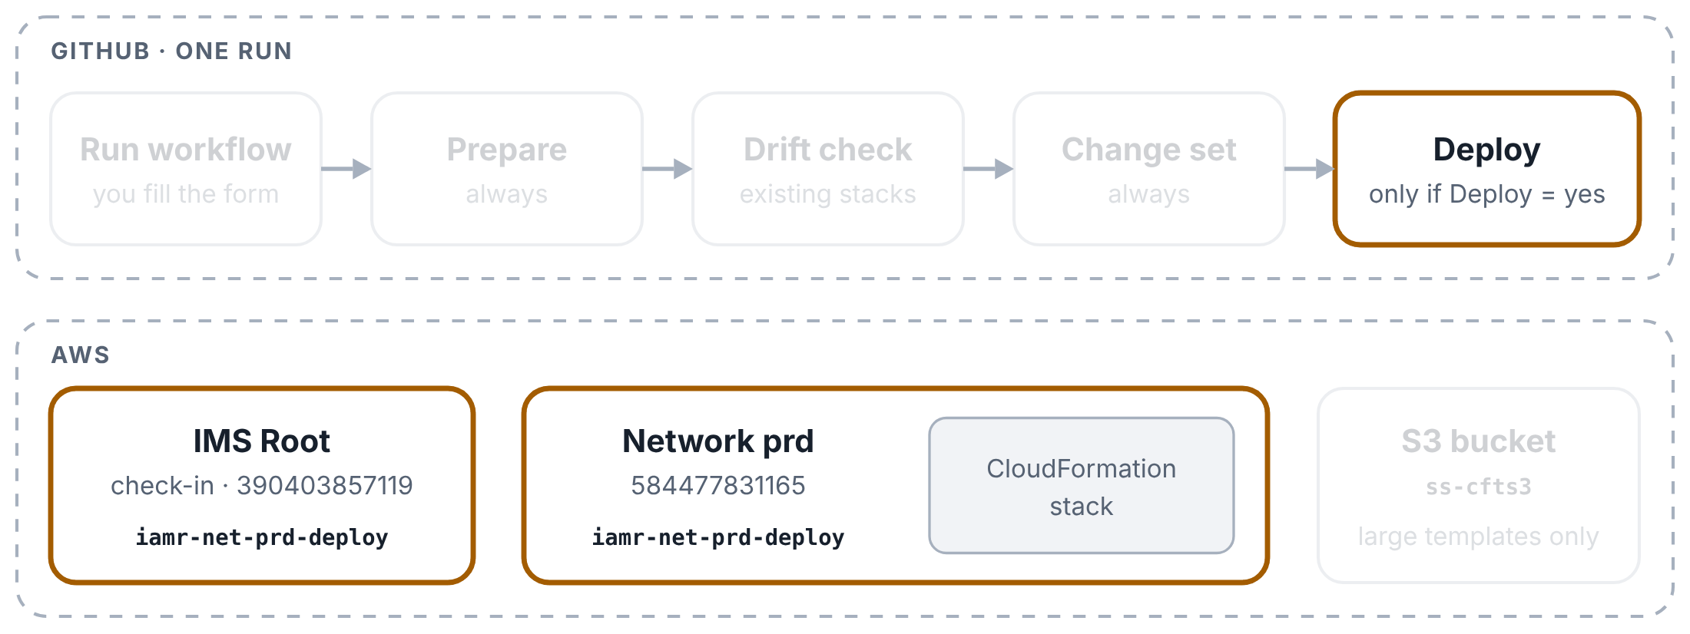
CloudFormation pipeline: one run
YOUR NEW PIPELINES EXPLAINED
Step 10 of 11
One run for Infrastructure-PRD-NetworkServices (network prd). Top row: the boxes on the run page. Bottom row: what each box touches in AWS.
Deploy: execute and follow
Only with Deploy = yes and something to change. If the change set would remove manual changes, this box goes ahead only when Remove manual changes = yes; otherwise it stops before executing and turns red: Not deployed. Then it signs in (both hops checked), executes the change set and prints the stack’s events every 15 seconds until CloudFormation finishes.

Slide 28
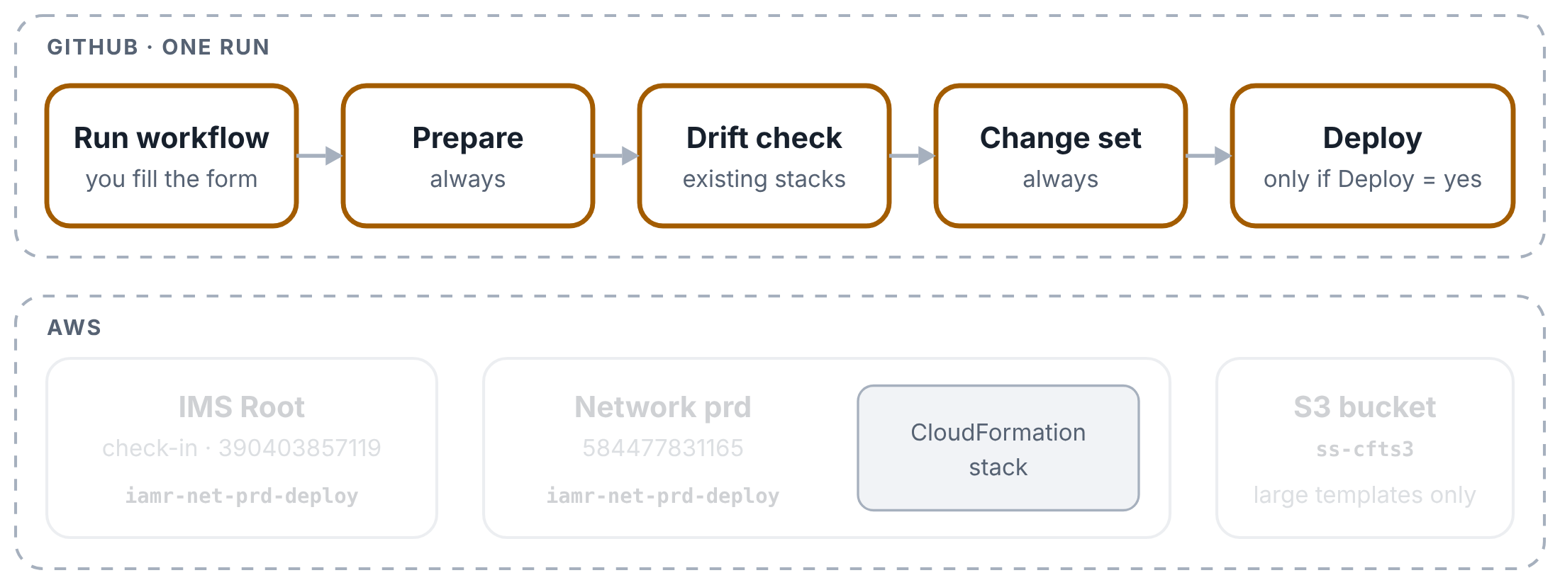
CloudFormation pipeline: one run
YOUR NEW PIPELINES EXPLAINED
Step 11 of 11
One run for Infrastructure-PRD-NetworkServices (network prd). Top row: the boxes on the run page. Bottom row: what each box touches in AWS.
The result
Green boxes and a ✅ Deployed notice, or a red box saying what failed and what to do. If an update fails, CloudFormation puts the stack back as it was. The Summary page keeps the plan, both hop roles, the drift report, the change list and every stack event.

Slide 29
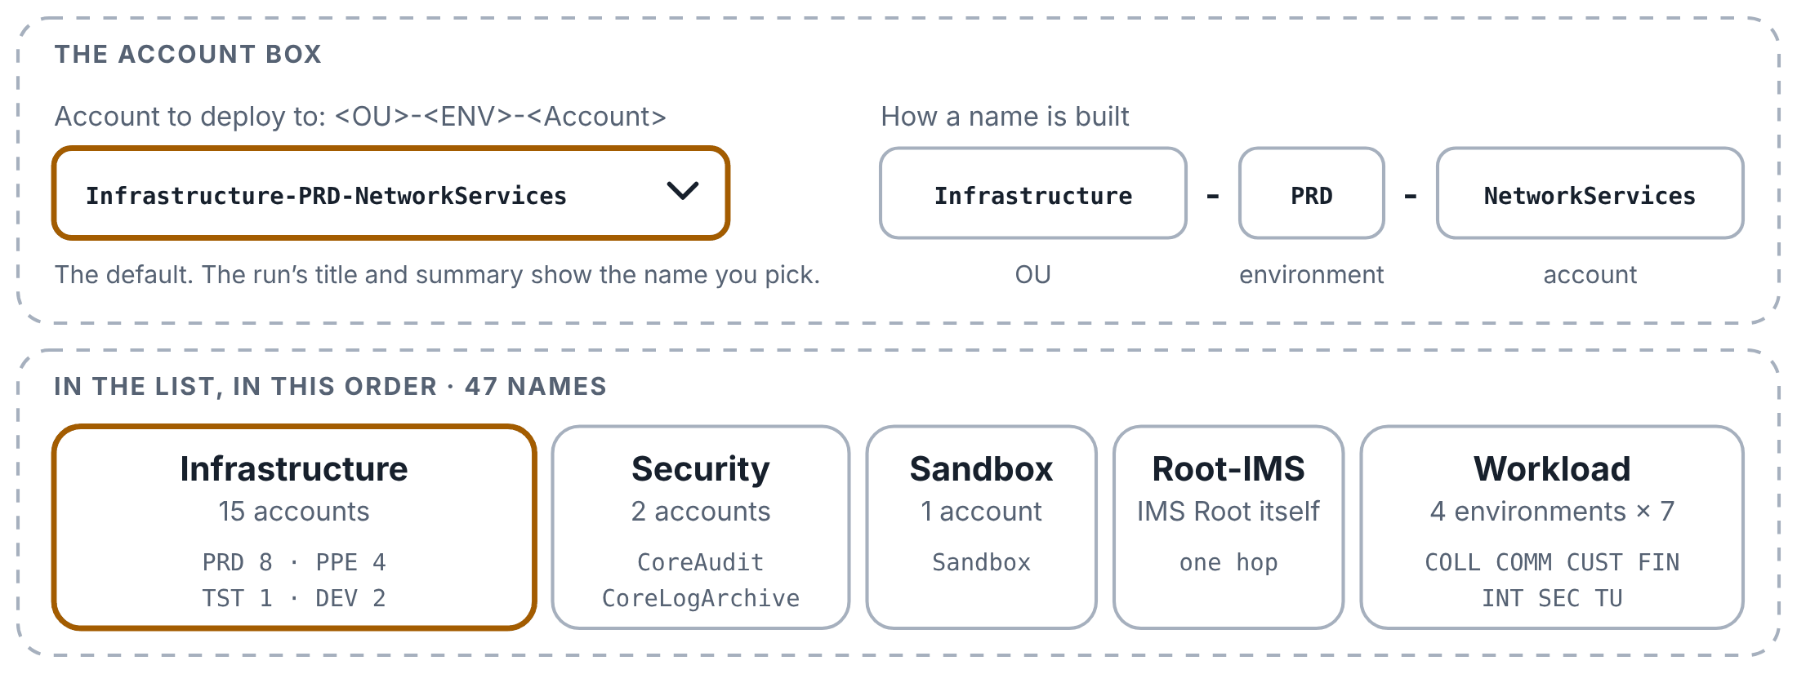
Any of the 47 accounts
YOUR NEW PIPELINES EXPLAINED
Step 1 of 3
New: the Account box lists 47 accounts by a friendly name, and Prepare turns your pick into the two roles.
Friendly names, in OU order
The Account box lists 47 names built as <OU>-<ENV>-<Account>: 15 Infrastructure, 2 Security, Sandbox, Root-IMS and 28 Workload, in that order. It starts on Infrastructure-PRD-NetworkServices. The old list had only NETWORK, PPE-NETWORK and TST-NETWORK.

Slide 30
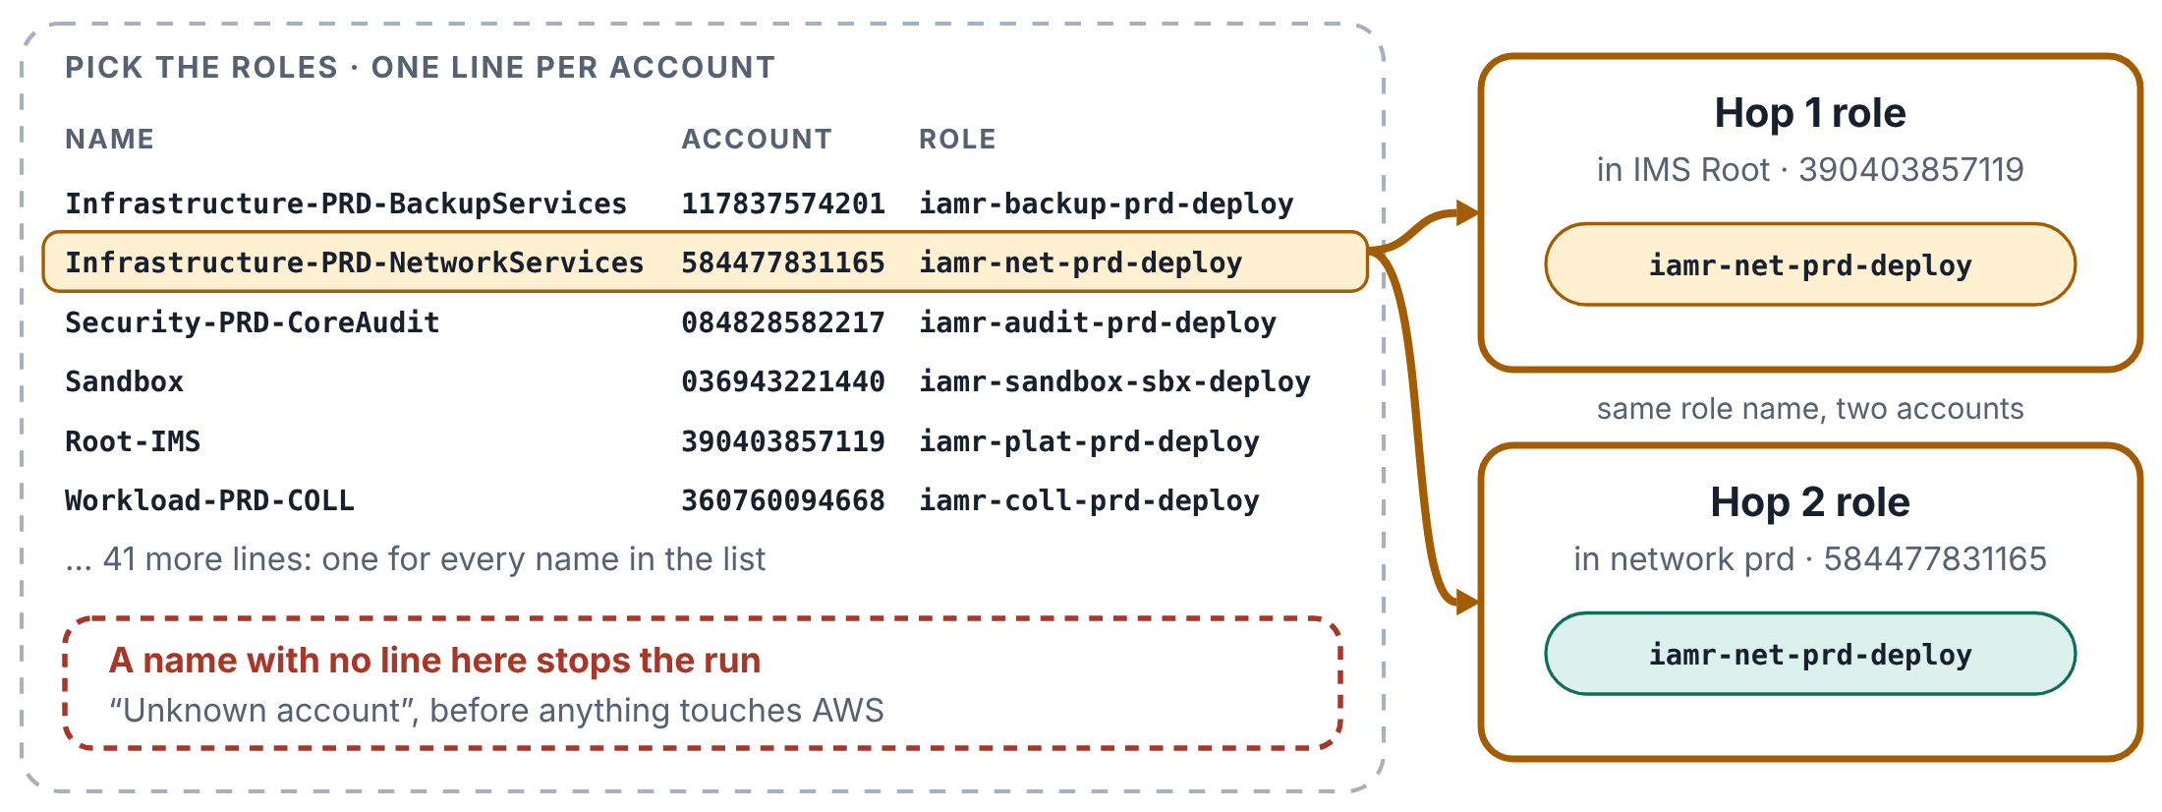
Any of the 47 accounts
YOUR NEW PIPELINES EXPLAINED
Step 2 of 3
New: the Account box lists 47 accounts by a friendly name, and Prepare turns your pick into the two roles.
One line per account in the file
Pick the roles finds your pick in a table in the pipeline file: the account number and the role name. The hop 1 role is that name in IMS Root, the hop 2 role is the same name in the account. If a name in the list has no line in the table, the run stops before it touches AWS.

Slide 31
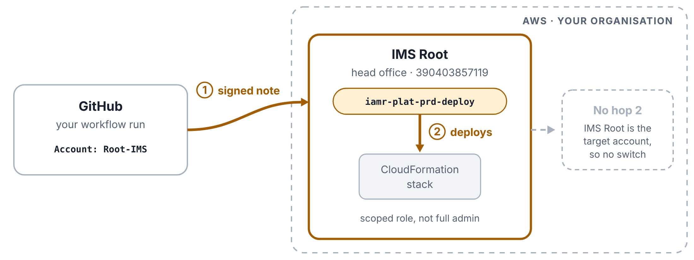
Any of the 47 accounts
YOUR NEW PIPELINES EXPLAINED
Step 3 of 3
New: the Account box lists 47 accounts by a friendly name, and Prepare turns your pick into the two roles.
Root-IMS: one hop
For Root-IMS the stack lives in IMS Root itself, so hop 1 already lands in the right account, as iamr-plat-prd-deploy. The switch and the hop 2 check are skipped, and the summary says so. This role is scoped, not full admin: it can deploy only what its own policy allows.

Slide 32
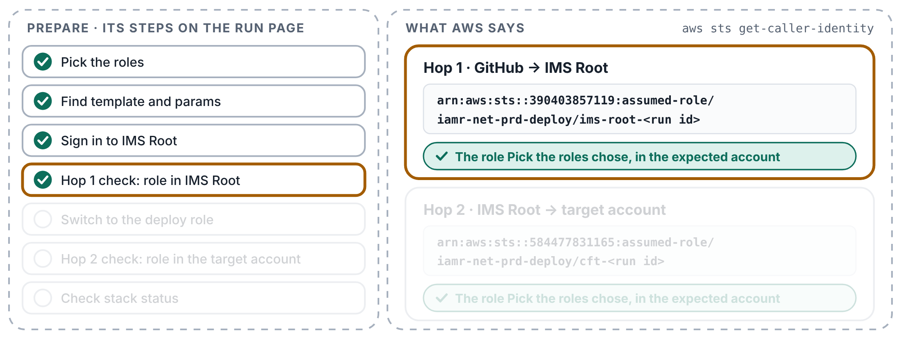
Hop 1 and hop 2, shown and checked
YOUR NEW PIPELINES EXPLAINED
Step 1 of 4
New: after each hop, every box asks AWS which role it now holds, prints it, and stops if it is the wrong one.
Hop 1: which role in IMS Root?
Right after Sign in to IMS Root, the box asks AWS who it is now (aws sts get-caller-identity) and prints the answer as 🔐 Hop 1. It must be the role Pick the roles chose, in IMS Root 390403857119.

Slide 33
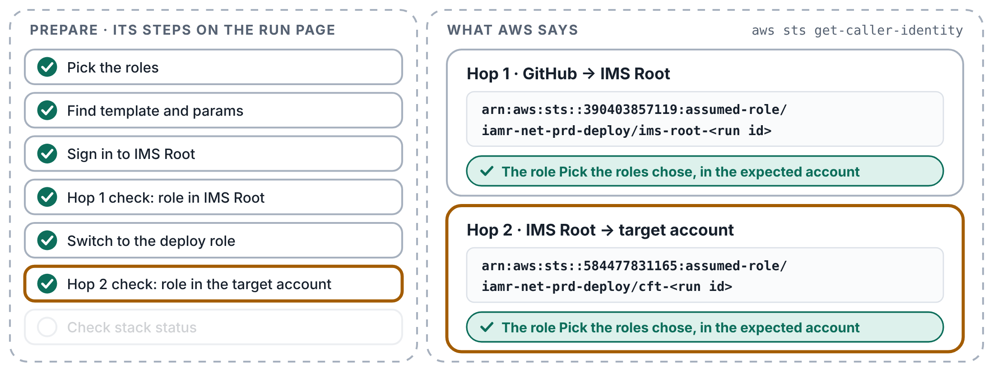
Hop 1 and hop 2, shown and checked
YOUR NEW PIPELINES EXPLAINED
Step 2 of 4
New: after each hop, every box asks AWS which role it now holds, prints it, and stops if it is the wrong one.
Hop 2: which role in the account?
After the switch it asks again and prints 🔐 Hop 2: the same role name, now in the account you picked. Each line ends with the session name, ims-root-<run id> or cft-<run id>, so the run can also be found in CloudTrail.

Slide 34
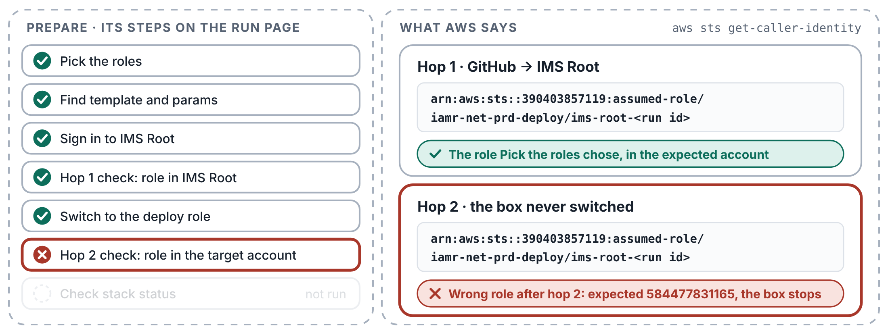
Hop 1 and hop 2, shown and checked
YOUR NEW PIPELINES EXPLAINED
Step 3 of 4
New: after each hop, every box asks AWS which role it now holds, prints it, and stops if it is the wrong one.
A wrong role stops the box
If AWS hands back any other role or account, for example because a box never switched and is still in IMS Root, the box stops with Wrong role after hop 2, saying what it expected and what it got. Nothing after that step runs, so no stack work happens under the wrong role.

Slide 35
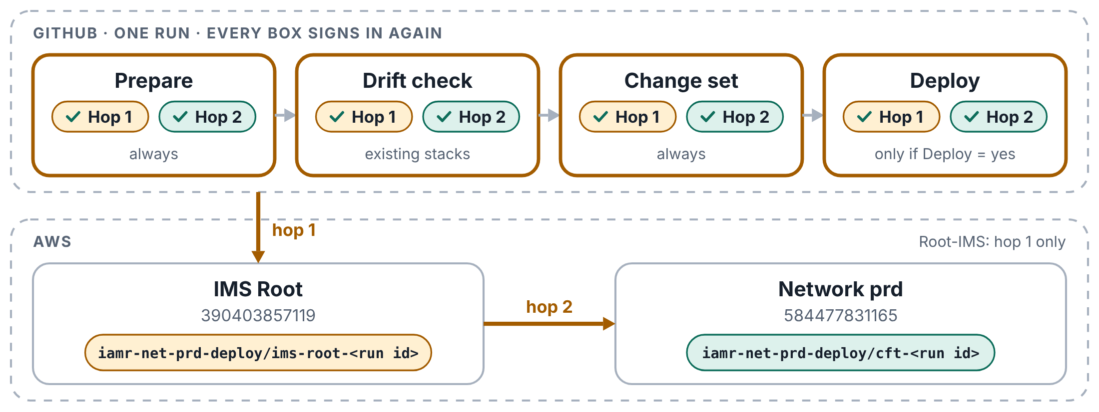
Hop 1 and hop 2, shown and checked
YOUR NEW PIPELINES EXPLAINED
Step 4 of 4
New: after each hop, every box asks AWS which role it now holds, prints it, and stops if it is the wrong one.
Every box checks, every time
Each box starts on a fresh computer and signs in again, so Prepare, Drift check, Change set and Deploy each print and check both hops. The Prepare summary shows both roles. For Root-IMS there is only hop 1.

Slide 36
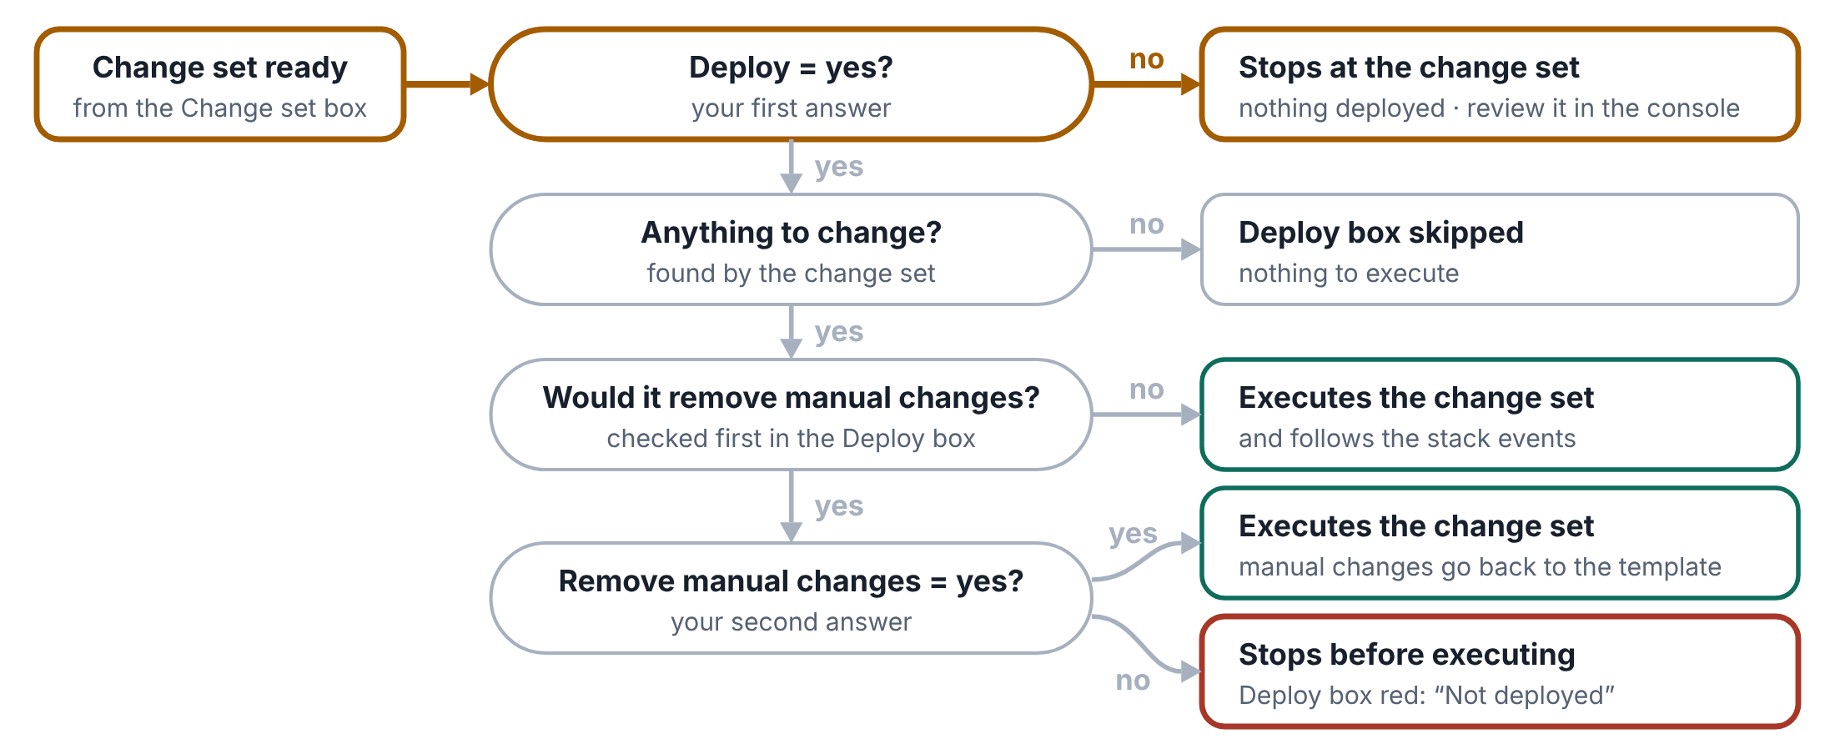
Deploy and manual changes
YOUR NEW PIPELINES EXPLAINED
Step 1 of 4
What the run does with your two answers, Deploy and Remove manual changes, once the change set is ready.
Two answers decide how a run ends
Deploy and Remove manual changes are both no unless you change them. With Deploy = no, every run ends at the change set: nothing is deployed, and you review and execute it in the AWS console yourself.

Slide 37
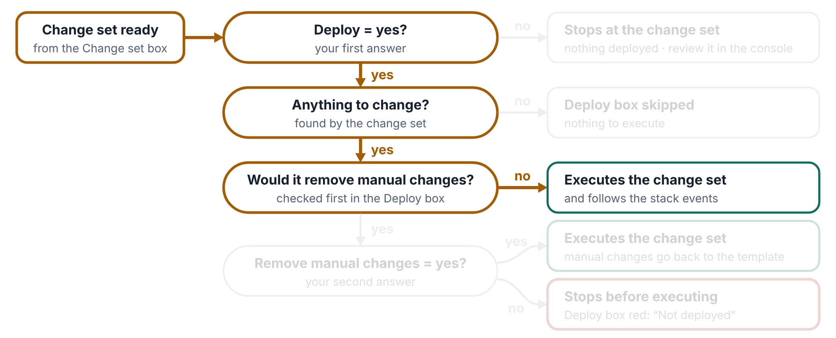
Deploy and manual changes
YOUR NEW PIPELINES EXPLAINED
Step 2 of 4
What the run does with your two answers, Deploy and Remove manual changes, once the change set is ready.
No manual changes: it deploys
With Deploy = yes, the Deploy box runs only if the change set has something to change. Its first step checks one thing: would this change set remove manual changes? If not, it signs in, executes the change set and follows the stack events.

Slide 38
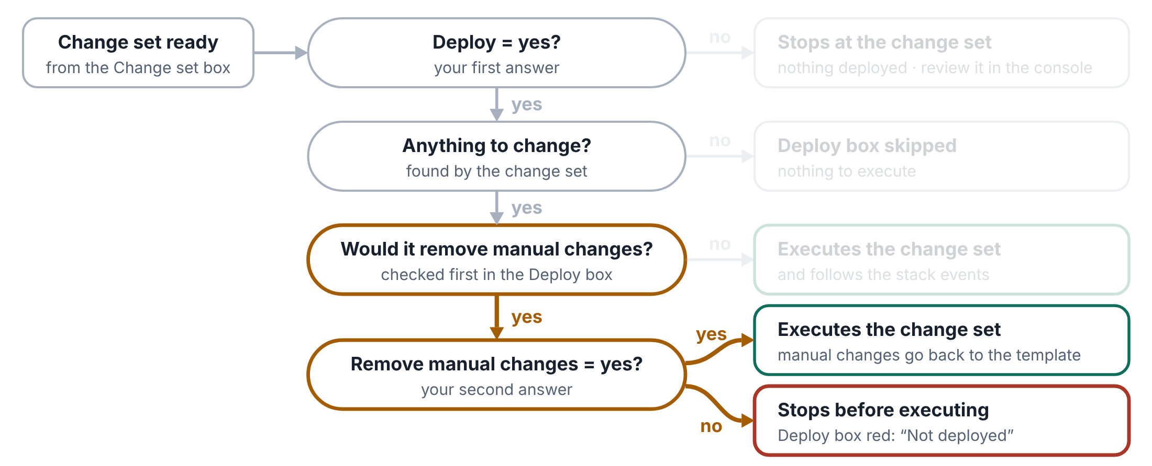
Deploy and manual changes
YOUR NEW PIPELINES EXPLAINED
Step 3 of 4
What the run does with your two answers, Deploy and Remove manual changes, once the change set is ready.
Manual changes: the second answer decides
With Remove manual changes = yes, it executes and the manual changes go back to the template values. With no, it stops before executing anything: the Deploy box turns red with Not deployed – would remove manual changes, and the stack is not touched.

Slide 39
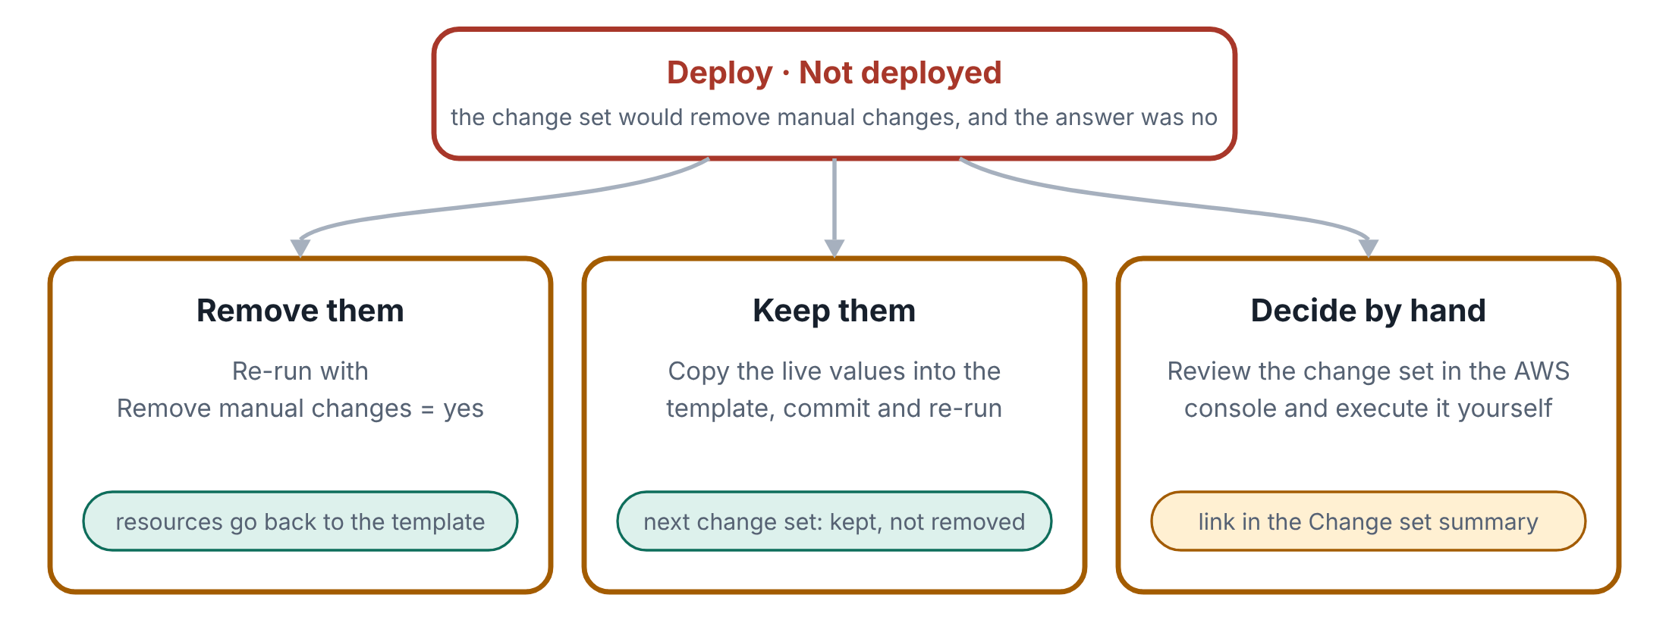
Deploy and manual changes
YOUR NEW PIPELINES EXPLAINED
Step 4 of 4
What the run does with your two answers, Deploy and Remove manual changes, once the change set is ready.
Three ways forward
The change set stays ready, and the Change set box lists each manual change it would remove. Re-run with Remove manual changes = yes to remove them, copy the live values into the template to keep them, or review the change set in the console and execute it yourself.

Slide 40

The pipeline on screen
YOUR NEW PIPELINES EXPLAINED
Screen 1 of 9
What you see on GitHub and in AWS when the new pipeline runs.
SCREENSHOT TO ADD
Actions → CloudFormation Stack using S3 as required → Run workflow, with the Account list open.
Paste it, fit it inside this box, then delete the box.
The Run workflow form
The Account list with its friendly names, and Deploy and Remove manual changes, both no unless you change them.
Notes:
SCREENSHOT TO ADD: Actions → CloudFormation Stack using S3 as required → Run workflow, with the Account list open.
What it shows: The Account list with its friendly names, and Deploy and Remove manual changes, both no unless you change them.
Paste the screenshot, fit it inside the dashed box, then delete the dashed box, its camera icon and its text.

Slide 41
The pipeline on screen
YOUR NEW PIPELINES EXPLAINED
Screen 2 of 9
What you see on GitHub and in AWS when the new pipeline runs.
SCREENSHOT TO ADD
The run’s page after it finishes: the title and the four boxes, Prepare → Drift check → Change set → Deploy.
Paste it, fit it inside this box, then delete the box.
The run page
The run’s title gives the stack, the account and the Region. Green boxes passed and grey ones were skipped: Deploy with Deploy = no, Drift check for a new stack.
Notes:
SCREENSHOT TO ADD: The run’s page after it finishes: the title and the four boxes, Prepare → Drift check → Change set → Deploy.
What it shows: The run’s title gives the stack, the account and the Region. Green boxes passed and grey ones were skipped: Deploy with Deploy = no, Drift check for a new stack.
Paste the screenshot, fit it inside the dashed box, then delete the dashed box, its camera icon and its text.

Slide 42
The pipeline on screen
YOUR NEW PIPELINES EXPLAINED
Screen 3 of 9
What you see on GitHub and in AWS when the new pipeline runs.
SCREENSHOT TO ADD
Open the Prepare box and expand “Hop 1 check: role in IMS Root” and “Hop 2 check: role in the target account”.
Paste it, fit it inside this box, then delete the box.
Both hops in the log
🔐 Hop 1 shows the role in IMS Root (390403857119) and 🔐 Hop 2 the role in the account you picked, each ending in this run’s session name.
Notes:
SCREENSHOT TO ADD: Open the Prepare box and expand “Hop 1 check: role in IMS Root” and “Hop 2 check: role in the target account”.
What it shows: 🔐 Hop 1 shows the role in IMS Root (390403857119) and 🔐 Hop 2 the role in the account you picked, each ending in this run’s session name.
Paste the screenshot, fit it inside the dashed box, then delete the dashed box, its camera icon and its text.

Slide 43
The pipeline on screen
YOUR NEW PIPELINES EXPLAINED
Screen 4 of 9
What you see on GitHub and in AWS when the new pipeline runs.
SCREENSHOT TO ADD
The run’s Summary page, 🧰 Prepare table. Your screenshot from the Sandbox run 376135007 fits here.
Paste it, fit it inside this box, then delete the box.
Both hops on the summary page
The Prepare table: the stack, the account, the roles after hop 1 and hop 2, the template, the plan and the Deploy answer.
Notes:
SCREENSHOT TO ADD: The run’s Summary page, 🧰 Prepare table. Your screenshot from the Sandbox run 376135007 fits here.
What it shows: The Prepare table: the stack, the account, the roles after hop 1 and hop 2, the template, the plan and the Deploy answer.
Paste the screenshot, fit it inside the dashed box, then delete the dashed box, its camera icon and its text.

Slide 44
The pipeline on screen
YOUR NEW PIPELINES EXPLAINED
Screen 5 of 9
What you see on GitHub and in AWS when the new pipeline runs.
SCREENSHOT TO ADD
Summary page, 🔎 Drift check section – ideally from a stack with a manual change, so the drift table shows.
Paste it, fit it inside this box, then delete the box.
The drift check
Changes made by hand to the stack’s resources, listed for information. The run carries on to the change set either way.
Notes:
SCREENSHOT TO ADD: Summary page, 🔎 Drift check section – ideally from a stack with a manual change, so the drift table shows.
What it shows: Changes made by hand to the stack’s resources, listed for information. The run carries on to the change set either way.
Paste the screenshot, fit it inside the dashed box, then delete the dashed box, its camera icon and its text.

Slide 45
The pipeline on screen
YOUR NEW PIPELINES EXPLAINED
Screen 6 of 9
What you see on GitHub and in AWS when the new pipeline runs.
SCREENSHOT TO ADD
Summary page, 📝 Change set section from a run with Deploy = no. Optionally the change set in the AWS console, from its link.
Paste it, fit it inside this box, then delete the box.
The change set, ready for review
What executing the change set would do: manual changes removed, resources added, modified and removed, with a link to it in the AWS console. Nothing is deployed yet.
Notes:
SCREENSHOT TO ADD: Summary page, 📝 Change set section from a run with Deploy = no. Optionally the change set in the AWS console, from its link.
What it shows: What executing the change set would do: manual changes removed, resources added, modified and removed, with a link to it in the AWS console. Nothing is deployed yet.
Paste the screenshot, fit it inside the dashed box, then delete the dashed box, its camera icon and its text.

Slide 46
The pipeline on screen
YOUR NEW PIPELINES EXPLAINED
Screen 7 of 9
What you see on GitHub and in AWS when the new pipeline runs.
SCREENSHOT TO ADD
A run with Deploy = yes and Remove manual changes = no on a stack with a manual change: the red Deploy box and its ✋ Not deployed summary.
Paste it, fit it inside this box, then delete the box.
Stopped: it would remove manual changes
Deploy = yes, Remove manual changes = no, and the change set would undo a manual change: the Deploy box stops before executing, and the summary gives the three ways forward.
Notes:
SCREENSHOT TO ADD: A run with Deploy = yes and Remove manual changes = no on a stack with a manual change: the red Deploy box and its ✋ Not deployed summary.
What it shows: Deploy = yes, Remove manual changes = no, and the change set would undo a manual change: the Deploy box stops before executing, and the summary gives the three ways forward.
Paste the screenshot, fit it inside the dashed box, then delete the dashed box, its camera icon and its text.

Slide 47
The pipeline on screen
YOUR NEW PIPELINES EXPLAINED
Screen 8 of 9
What you see on GitHub and in AWS when the new pipeline runs.
SCREENSHOT TO ADD
A run with Deploy = yes: the green Deploy box and the 🚀 Deploy summary with ✅ Deployed and the stack events.
Paste it, fit it inside this box, then delete the box.
Deployed
The Deploy box executed the change set and followed it to the end: the stack’s final status, a link to the stack in the AWS console and every stack event.
Notes:
SCREENSHOT TO ADD: A run with Deploy = yes: the green Deploy box and the 🚀 Deploy summary with ✅ Deployed and the stack events.
What it shows: The Deploy box executed the change set and followed it to the end: the stack’s final status, a link to the stack in the AWS console and every stack event.
Paste the screenshot, fit it inside the dashed box, then delete the dashed box, its camera icon and its text.

Slide 48
The pipeline on screen
YOUR NEW PIPELINES EXPLAINED
Screen 9 of 9
What you see on GitHub and in AWS when the new pipeline runs.
SCREENSHOT TO ADD
The report table from a Test account setups run (all accounts).
Optional: delete this slide if you’d rather not show the test pipeline.
Paste it, fit it inside this box, then delete the box.
Every account checked
One run of the Test account setups pipeline signs in to every account in the list, through both hops (one for Root-IMS), and checks what each role can do, without deploying anything.
Notes:
SCREENSHOT TO ADD: The report table from a Test account setups run (all accounts). Optional: delete this slide if you’d rather not show the test pipeline.
What it shows: One run of the Test account setups pipeline signs in to every account in the list, through both hops (one for Root-IMS), and checks what each role can do, without deploying anything.
Paste the screenshot, fit it inside the dashed box, then delete the dashed box, its camera icon and its text.

Slide 49
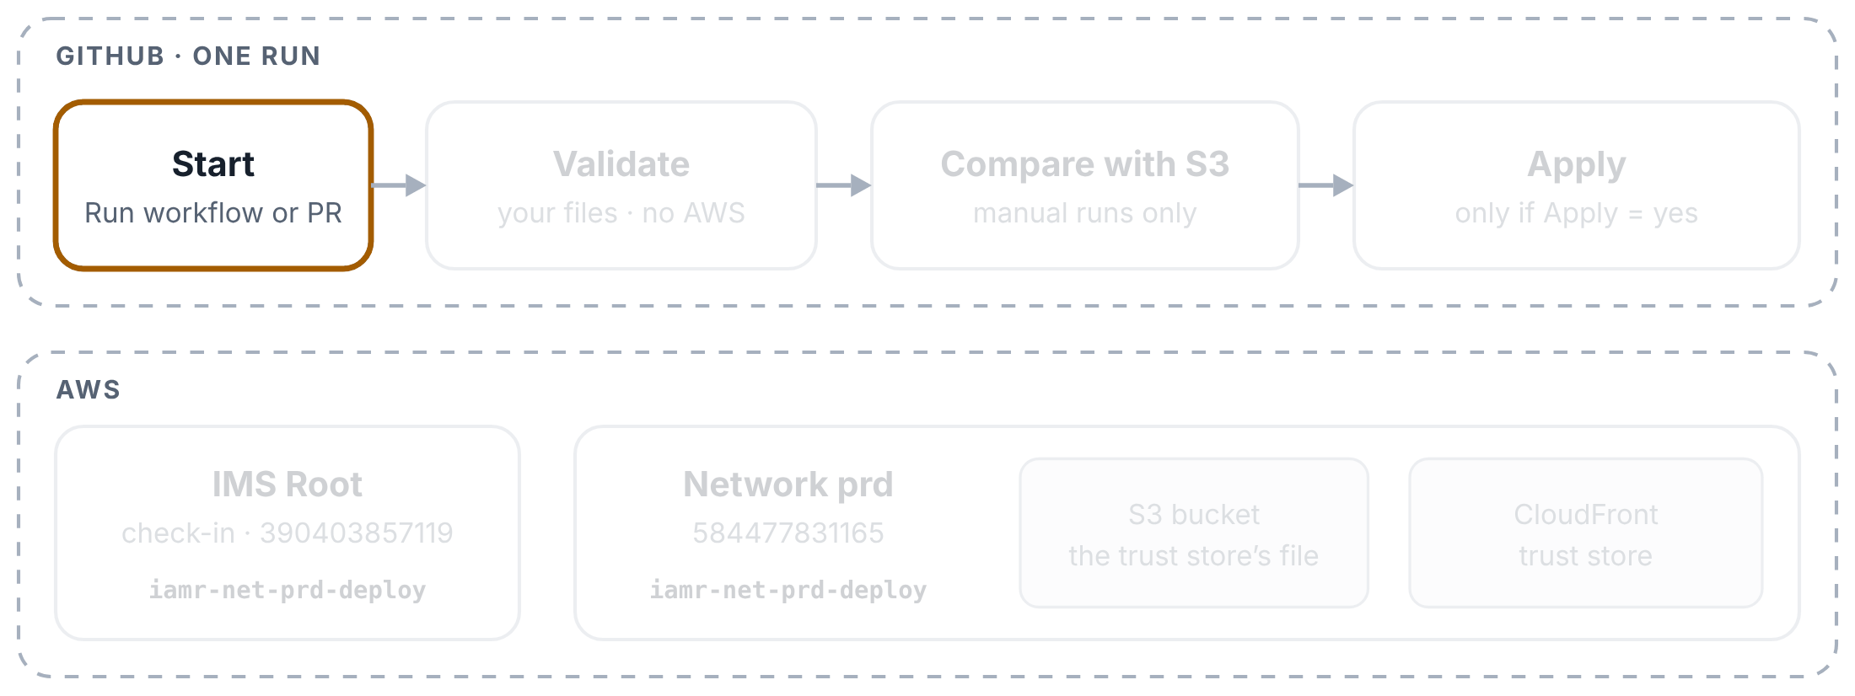
Trust store pipeline: a manual run
YOUR NEW PIPELINES EXPLAINED
Step 1 of 8
A manual run for prd with Apply = yes. ppe and tst work the same way, with their own role and account.
You start the run
Actions tab → Trust store → Run workflow (branch main). Pick the environment, and Apply: no to only compare, yes to put the file live.

Slide 50
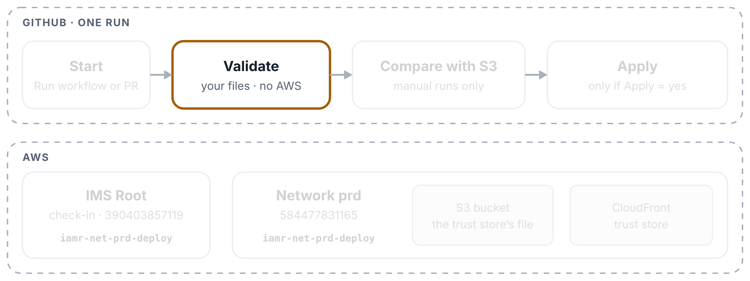
Trust store pipeline: a manual run
YOUR NEW PIPELINES EXPLAINED
Step 2 of 8
A manual run for prd with Apply = yes. ppe and tst work the same way, with their own role and account.
Validate picks the role
The first box works out the network account and the role for that environment, and writes a 🧭 Plan table from truststore.json, the file that says which trust store and which S3 file belong to the environment.

Slide 51
Trust store pipeline: a manual run
YOUR NEW PIPELINES EXPLAINED
Step 3 of 8
A manual run for prd with Apply = yes. ppe and tst work the same way, with their own role and account.
Validate checks the PEM file
It runs the team’s validate-truststore.sh as before, then truststore_update.py checks the file against CloudFront’s rules: real CA certificates, allowed key types, at most 25 certificates, and so on. No AWS yet.

Slide 52
Trust store pipeline: a manual run
YOUR NEW PIPELINES EXPLAINED
Step 4 of 8
A manual run for prd with Apply = yes. ppe and tst work the same way, with their own role and account.
Validate checks truststore.json
Every value must be filled in, and account_id must be the account this environment signs in to. A wrong account stops the run here.

Slide 53
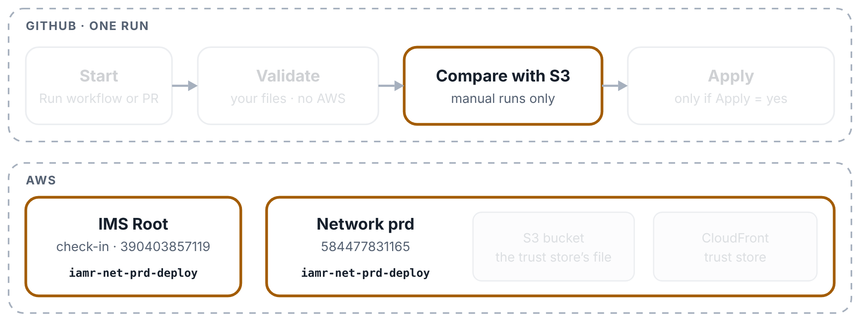
Trust store pipeline: a manual run
YOUR NEW PIPELINES EXPLAINED
Step 5 of 8
A manual run for prd with Apply = yes. ppe and tst work the same way, with their own role and account.
Compare signs in
The second box is the first one allowed to ask GitHub for a signed note. It checks in at IMS Root and swaps for the network account’s deploy role.

Slide 54
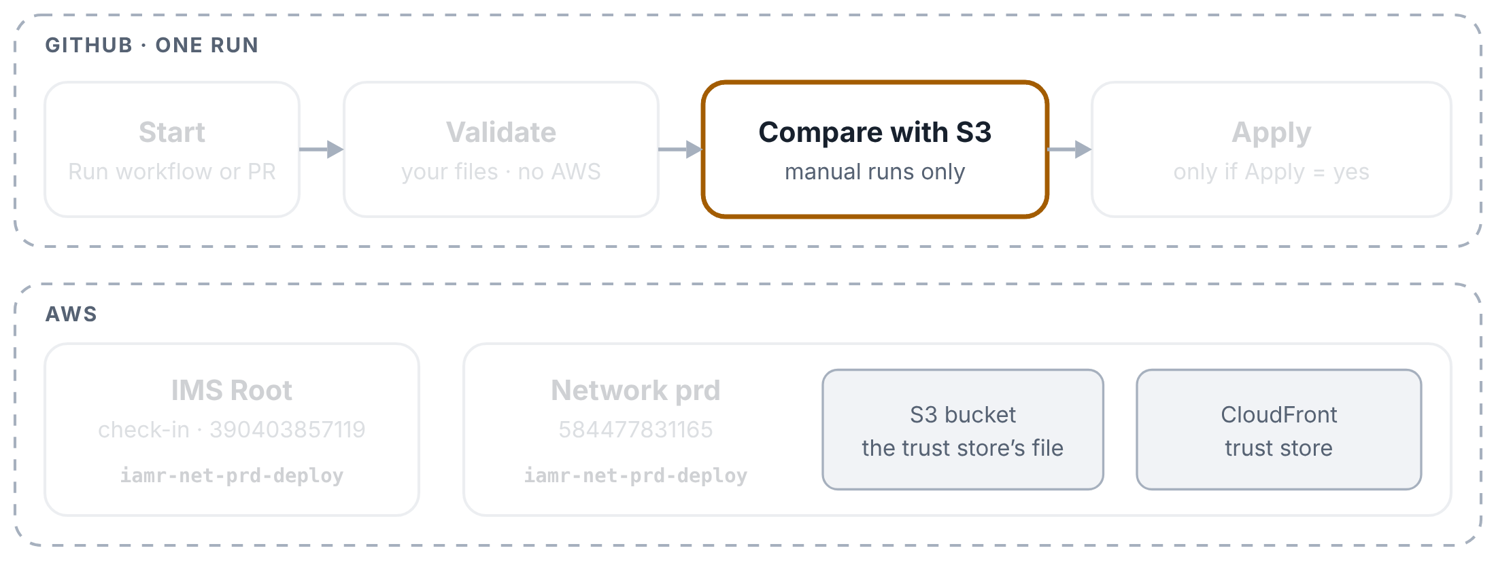
Trust store pipeline: a manual run
YOUR NEW PIPELINES EXPLAINED
Step 6 of 8
A manual run for prd with Apply = yes. ppe and tst work the same way, with their own role and account.
Compare: your file against S3
The script reads the trust store and downloads the file it was built from, then lists the certificates added, removed, replaced and unchanged. It changes nothing. With Apply = no the run ends here.

Slide 55
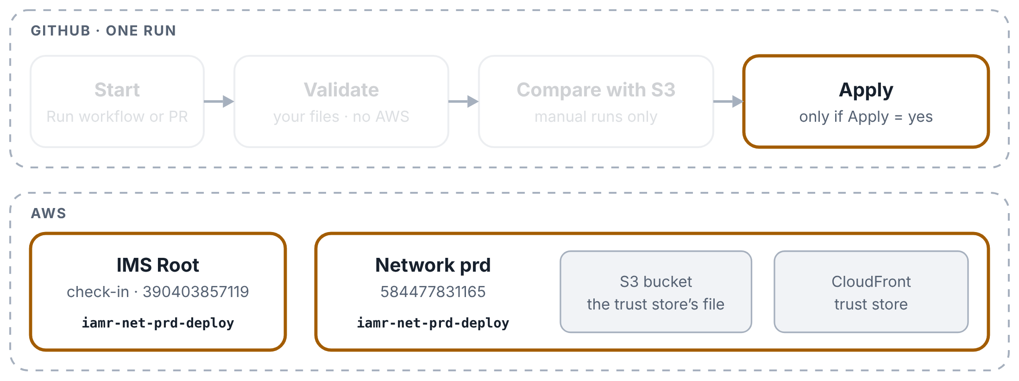
Trust store pipeline: a manual run
YOUR NEW PIPELINES EXPLAINED
Step 7 of 8
A manual run for prd with Apply = yes. ppe and tst work the same way, with their own role and account.
Apply: upload and update
Only with Apply = yes and something to apply. The third box signs in, saves the current S3 file, uploads yours (and reads it back), points the trust store at the new version, and waits until CloudFront says it is active.

Slide 56
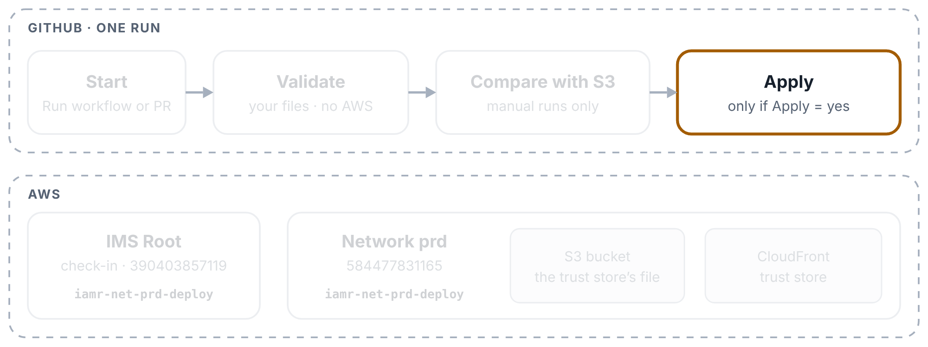
Trust store pipeline: a manual run
YOUR NEW PIPELINES EXPLAINED
Step 8 of 8
A manual run for prd with Apply = yes. ppe and tst work the same way, with their own role and account.
Apply keeps the old file
Even if something failed, the previous S3 file is kept as a download on the run page (an artifact), so you can always put it back.

Slide 57
Trust store pipeline: a pull request check
YOUR NEW PIPELINES EXPLAINED
Step 1 of 4
A pull request check: only the Validate box runs, and nothing touches AWS.
You open a pull request
In a branch, change an environment’s truststore.pem (for example, add a partner’s CA certificate) and open a pull request to main. The check starts by itself.

Slide 58
Trust store pipeline: a pull request check
YOUR NEW PIPELINES EXPLAINED
Step 2 of 4
A pull request check: only the Validate box runs, and nothing touches AWS.
Validate finds what changed
It compares your branch with main to see which environments’ files changed. If only the workflow or a script changed, it checks every environment.

Slide 59
Trust store pipeline: a pull request check
YOUR NEW PIPELINES EXPLAINED
Step 3 of 4
A pull request check: only the Validate box runs, and nothing touches AWS.
Validate checks each changed file
The same checks as a manual run, plus a list of the certificates your pull request adds and removes compared with main. Problems show up on the exact lines of the file in the pull request.

Slide 60
Trust store pipeline: a pull request check
YOUR NEW PIPELINES EXPLAINED
Step 4 of 4
A pull request check: only the Validate box runs, and nothing touches AWS.
Compare and Apply are skipped
They only run for Run workflow, so on a pull request their boxes are grey. A pull request can’t even ask GitHub for a signed note: the workflow gives that permission only to Compare and Apply.

Slide 61
WS2 DNS Pipelines Explained
3
PART 3 OF 4
The Export and Apply loop · Export: one zone, all zones · Apply: preview only, with approval
Both pipelines still sign in the old way, straight to Control Tower’s master key (checked on 31 October 2026).

Slide 62
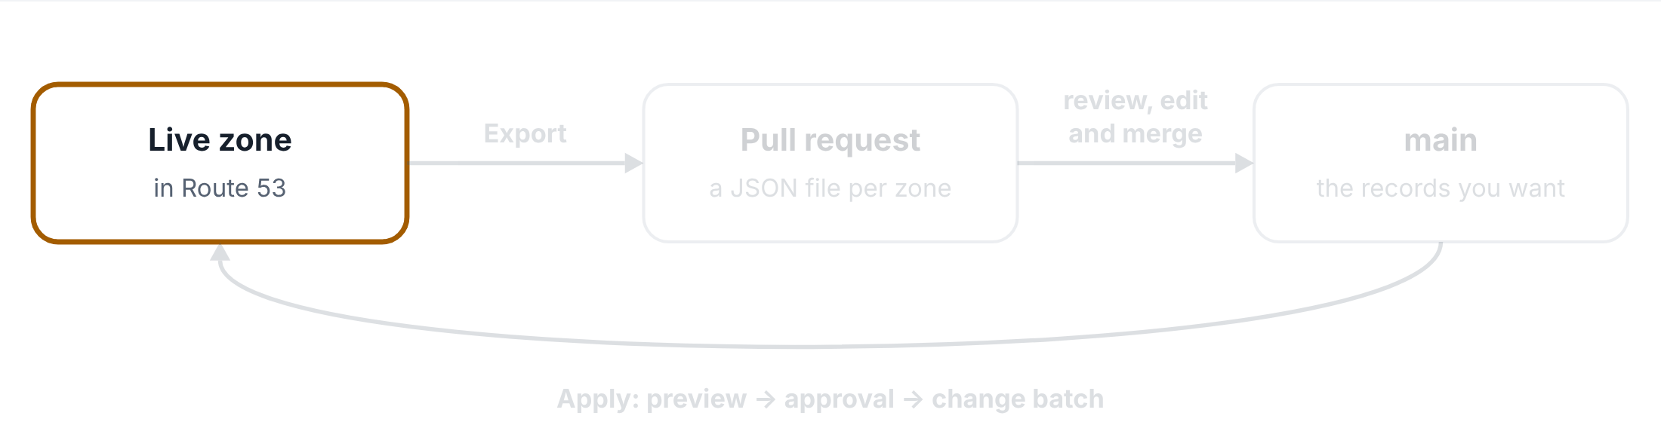
The Export and Apply loop
WS2 DNS PIPELINES EXPLAINED
Step 1 of 4
How the two WS2 pipelines work together: live records into Git, and back again.
The live zone
A Route 53 hosted zone holds the live DNS records.

Slide 63
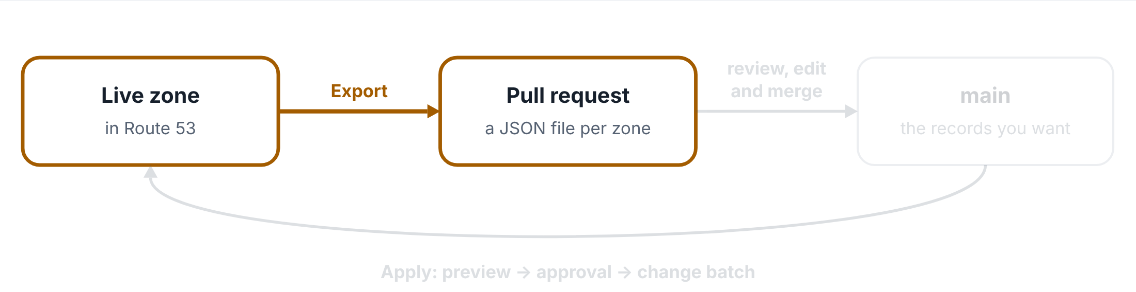
The Export and Apply loop
WS2 DNS PIPELINES EXPLAINED
Step 2 of 4
How the two WS2 pipelines work together: live records into Git, and back again.
Export: live records into a pull request
Export copies the zone’s live records into a JSON file, one per zone, and opens a pull request.

Slide 64
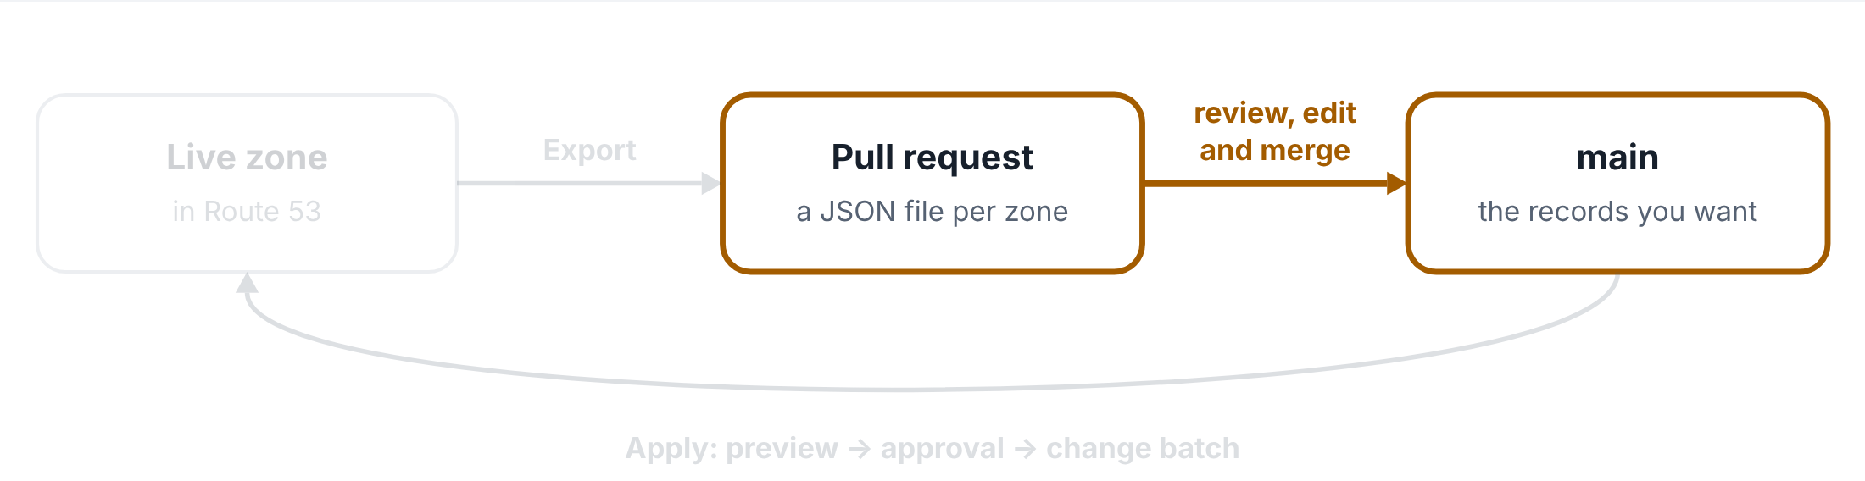
The Export and Apply loop
WS2 DNS PIPELINES EXPLAINED
Step 3 of 4
How the two WS2 pipelines work together: live records into Git, and back again.
Review, edit and merge
The team reviews the file, changes records if needed, and merges it into main. The file on main is the records you want.

Slide 65
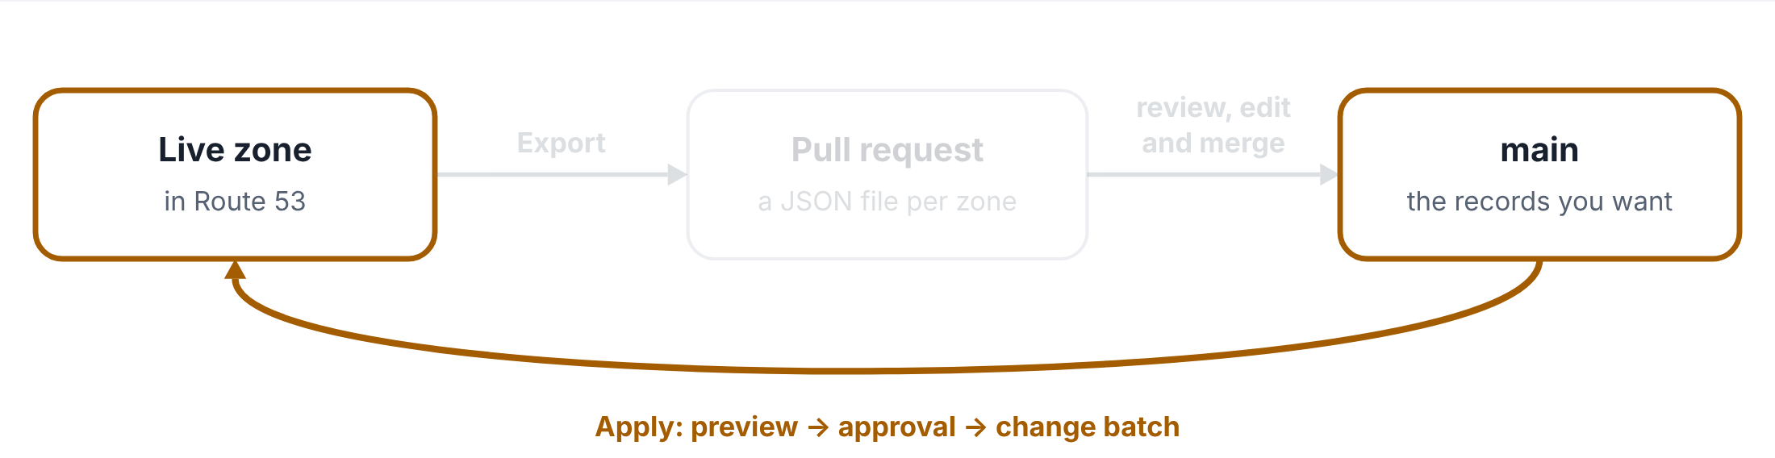
The Export and Apply loop
WS2 DNS PIPELINES EXPLAINED
Step 4 of 4
How the two WS2 pipelines work together: live records into Git, and back again.
Apply: main back to the live zone
Apply compares the file on main with the live zone, shows a preview, waits for approval outside sandbox, then makes the zone match.

Slide 66
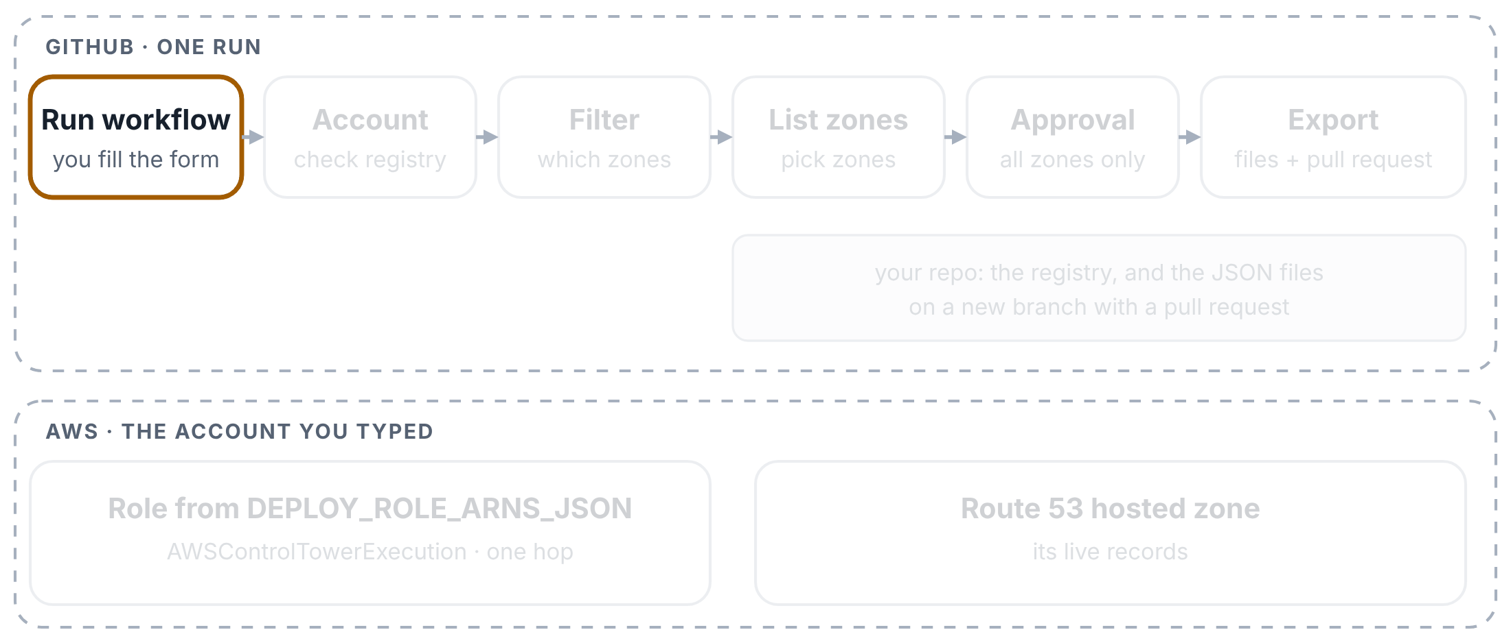
Export: one zone
WS2 DNS PIPELINES EXPLAINED
Step 1 of 9
Exporting one zone, named by its hosted zone ID. Top: GitHub and your repo. Bottom: the AWS account you typed.
You start the run
Actions tab → WS2 - DNS Records Export (batch) → Run workflow. Type the account (for example network-prod) and name one zone: its hosted zone ID, or its stack_id, its name, or the stack that created it.

Slide 67
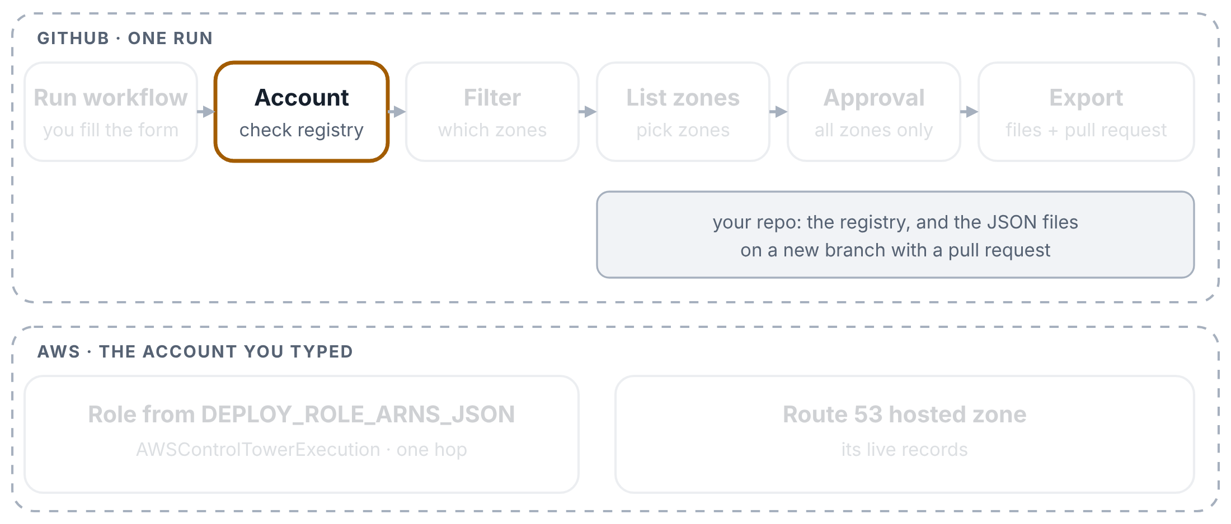
Export: one zone
WS2 DNS PIPELINES EXPLAINED
Step 2 of 9
Exporting one zone, named by its hosted zone ID. Top: GitHub and your repo. Bottom: the AWS account you typed.
The account is checked
The first box reads config/_accounts-registry.yaml from your repo. An account name that isn’t listed stops the run, and the error lists the valid names. No AWS yet.

Slide 68
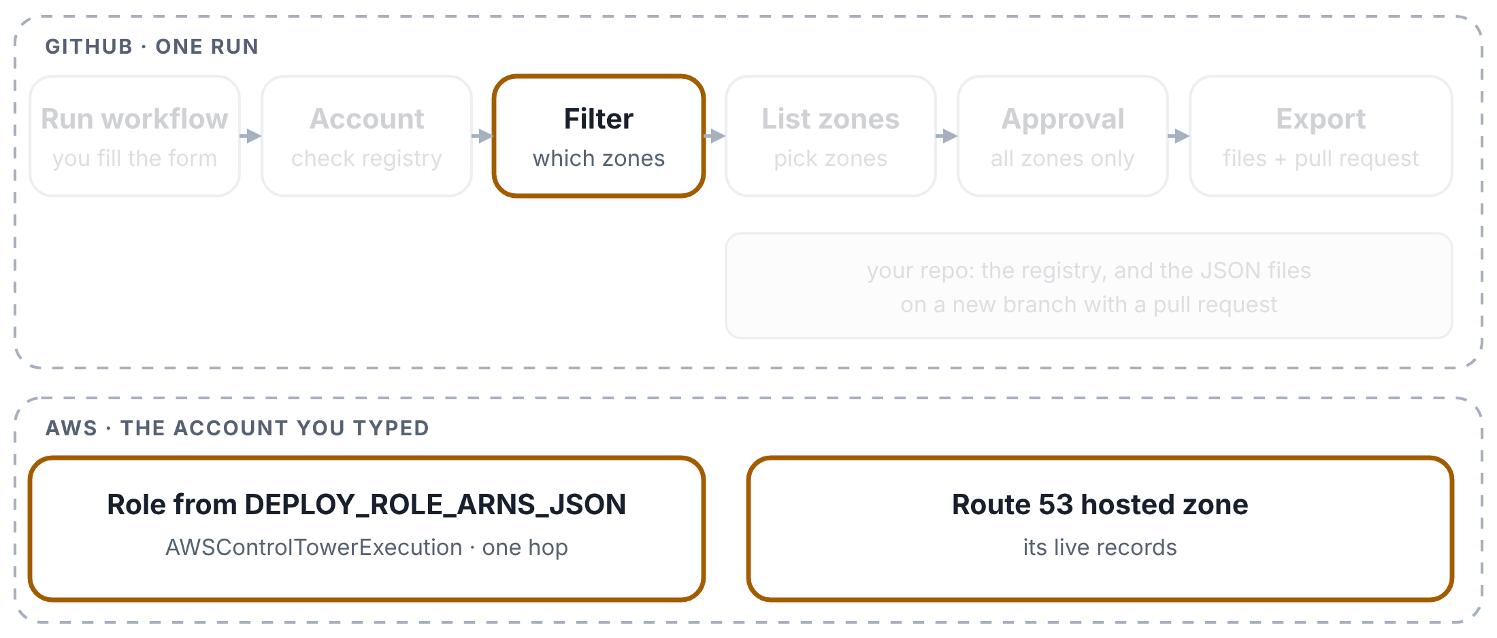
Export: one zone
WS2 DNS PIPELINES EXPLAINED
Step 3 of 9
Exporting one zone, named by its hosted zone ID. Top: GitHub and your repo. Bottom: the AWS account you typed.
The zone ID is looked up
Because you gave a zone ID, the second box signs in (the old way) and asks Route 53 for the zone’s name. It turns the name into the stack_id that the file will be named after.

Slide 69
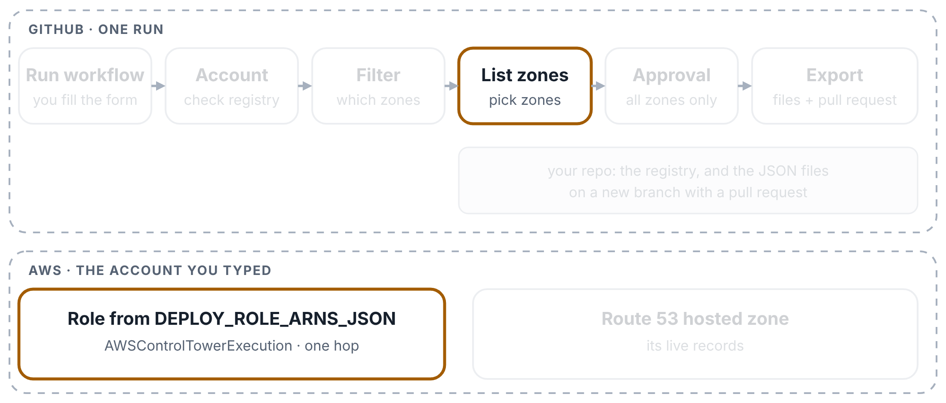
Export: one zone
WS2 DNS PIPELINES EXPLAINED
Step 4 of 9
Exporting one zone, named by its hosted zone ID. Top: GitHub and your repo. Bottom: the AWS account you typed.
List zones signs in
The third box looks up the role for your account in DEPLOY_ROLE_ARNS_JSON and signs straight in to that account, in one step.

Slide 70
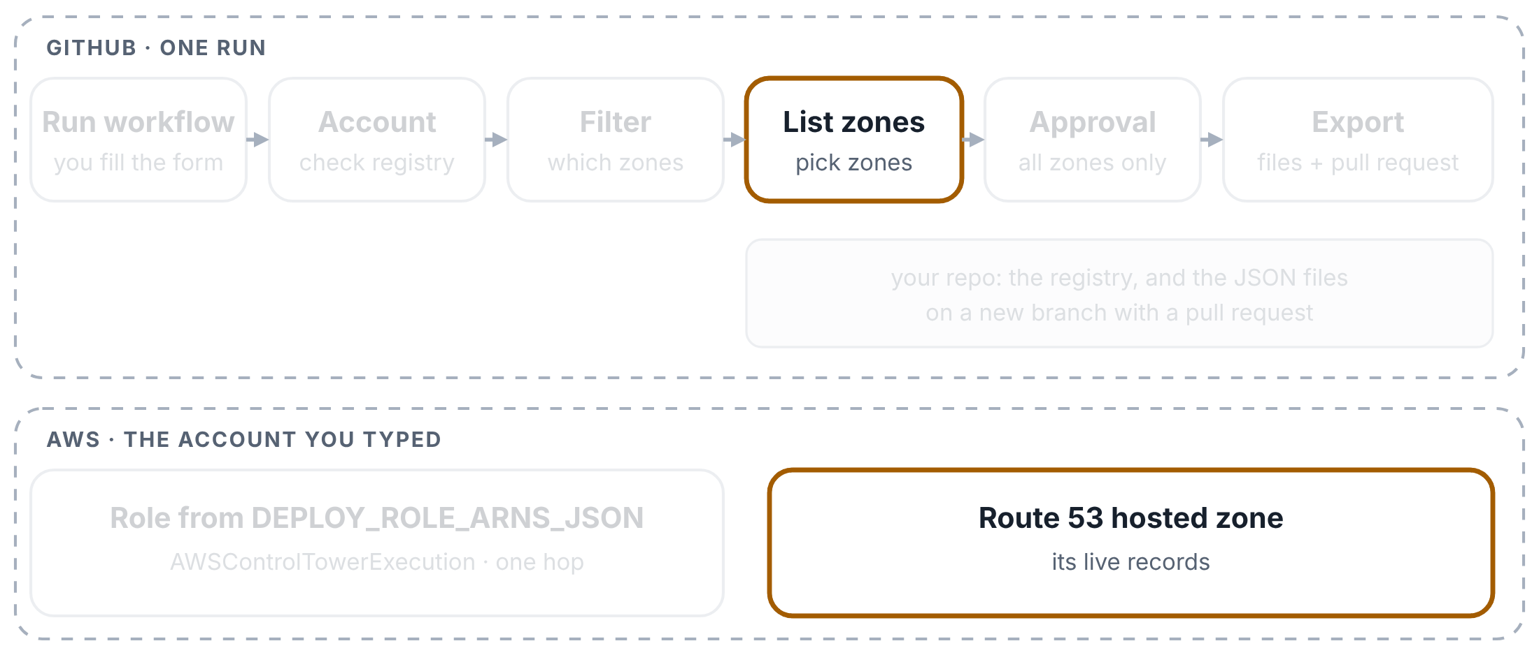
Export: one zone
WS2 DNS PIPELINES EXPLAINED
Step 5 of 9
Exporting one zone, named by its hosted zone ID. Top: GitHub and your repo. Bottom: the AWS account you typed.
List zones picks the zone
It lists every zone in the account, gives each one a stack_id, and picks yours. The choice goes to the next box as a small file (an artifact).

Slide 71
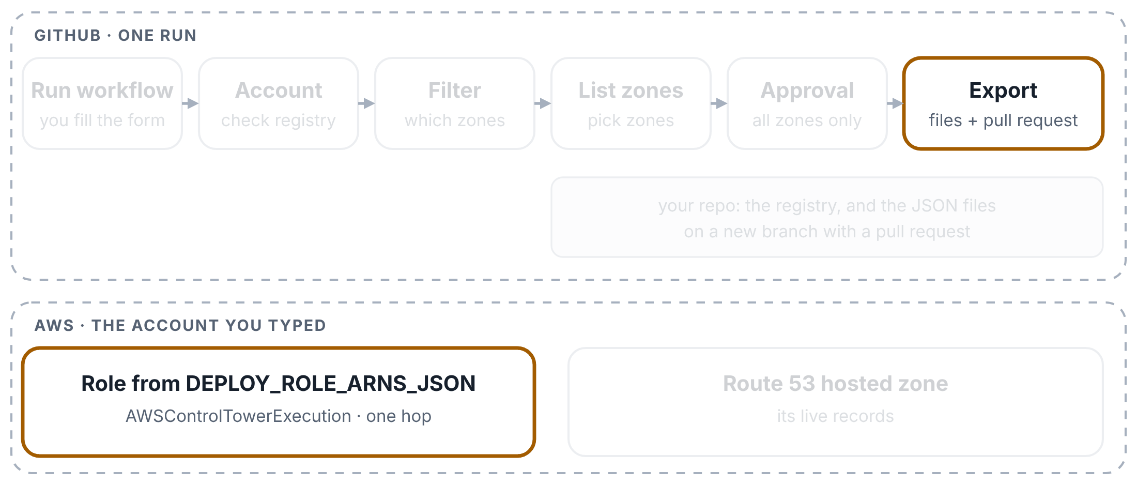
Export: one zone
WS2 DNS PIPELINES EXPLAINED
Step 6 of 9
Exporting one zone, named by its hosted zone ID. Top: GitHub and your repo. Bottom: the AWS account you typed.
Export signs in again
One zone needs no approval, so the approval box is grey. The Export box signs in once more and checks that it really got into the account.

Slide 72
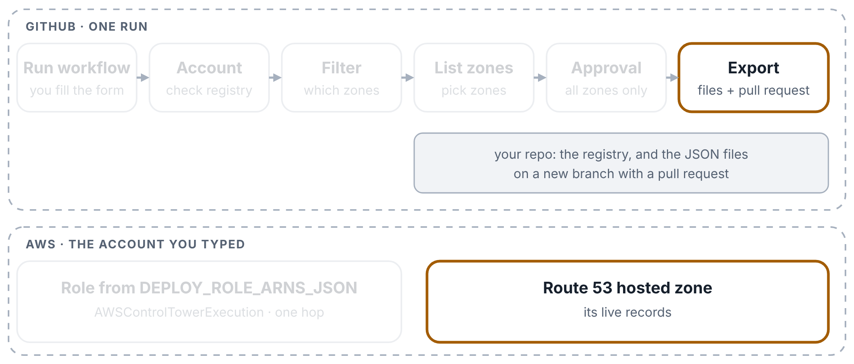
Export: one zone
WS2 DNS PIPELINES EXPLAINED
Step 7 of 9
Exporting one zone, named by its hosted zone ID. Top: GitHub and your repo. Bottom: the AWS account you typed.
The live records become a JSON file
dns_records_export.py reads the zone’s live records and writes config/accounts/<account>/networking/<stack_id>.json. ALIAS records, the SOA record and the zone’s own NS records are left out.

Slide 73
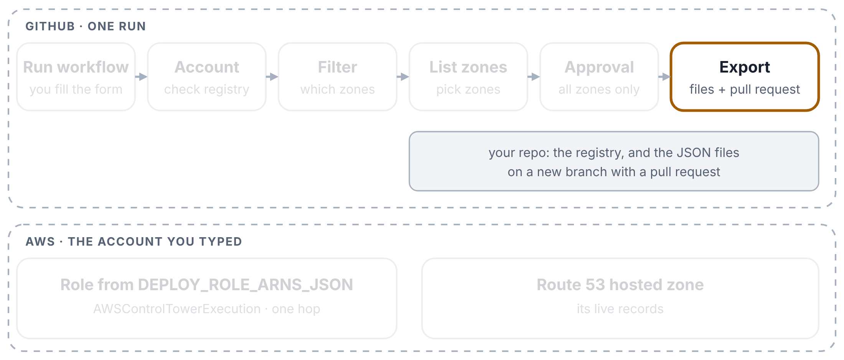
Export: one zone
WS2 DNS PIPELINES EXPLAINED
Step 8 of 9
Exporting one zone, named by its hosted zone ID. Top: GitHub and your repo. Bottom: the AWS account you typed.
A branch and a pull request
It commits the file to a new branch and opens a pull request into main, so the team can review it. The files are also kept on the run page for 30 days.

Slide 74

Export: one zone
WS2 DNS PIPELINES EXPLAINED
Step 9 of 9
Exporting one zone, named by its hosted zone ID. Top: GitHub and your repo. Bottom: the AWS account you typed.
What you do next
To change records, edit the file in the pull request and merge it. Then run the Apply pipeline for the same zone to put the change live.

Slide 75
Export: all zones
WS2 DNS PIPELINES EXPLAINED
Step 1 of 5
Exporting every zone of an account other than sandbox: the approval box waits for a reviewer.
You leave the zone empty
Type only the account. With no stack_id and no zone ID, the pipeline exports every zone in that account.

Slide 76

Export: all zones
WS2 DNS PIPELINES EXPLAINED
Step 2 of 5
Exporting every zone of an account other than sandbox: the approval box waits for a reviewer.
“All” mode
After the account check, the second box sees that neither field is filled in and switches to all mode. It doesn’t need AWS for that.

Slide 77

Export: all zones
WS2 DNS PIPELINES EXPLAINED
Step 3 of 5
Exporting every zone of an account other than sandbox: the approval box waits for a reviewer.
Every zone gets a name
List zones signs in and names every zone. A public and a private zone with the same name (split-horizon) get code class="nw">-public and code class="nw">-private endings, so both are exported.

Slide 78

Export: all zones
WS2 DNS PIPELINES EXPLAINED
Step 4 of 5
Exporting every zone of an account other than sandbox: the approval box waits for a reviewer.
Someone approves
For any account except sandbox, the approval box waits for a reviewer of the production environment. They should read the zone list in the List zones log first.

Slide 79

Export: all zones
WS2 DNS PIPELINES EXPLAINED
Step 5 of 5
Exporting every zone of an account other than sandbox: the approval box waits for a reviewer.
Export runs for every zone
Once approved, Export writes one file per zone, counts the exported, skipped and failed zones, and opens one pull request with all of them.

Slide 80

Apply: preview only
WS2 DNS PIPELINES EXPLAINED
Step 1 of 4
A preview-only run: nothing in Route 53 changes.
You start the run
Actions tab → WS2 -- DNS Records Apply (Gated / Audited) → Run workflow. Type the account and name one zone. Leave both tick boxes empty: this run only previews.

Slide 81

Apply: preview only
WS2 DNS PIPELINES EXPLAINED
Step 2 of 4
A preview-only run: nothing in Route 53 changes.
The account and the zone are checked
The first box checks the account against the registry, signs in the old way, and works out the zone. With no zone named, it stops: one zone per run.

Slide 82

Apply: preview only
WS2 DNS PIPELINES EXPLAINED
Step 3 of 4
A preview-only run: nothing in Route 53 changes.
Preview
The second box signs in again and runs dns_records_apply.py without --execute: it compares the JSON file on the branch you ran with the live zone and prints every change it would make. Nothing changes.

Slide 83

Apply: preview only
WS2 DNS PIPELINES EXPLAINED
Step 4 of 4
A preview-only run: nothing in Route 53 changes.
The run ends
Approval and Apply are grey, because execute_changes wasn’t ticked. The preview is on the Summary page.

Slide 84
Apply: with approval
WS2 DNS PIPELINES EXPLAINED
Step 1 of 5
A run with execute_changes ticked: preview, approval, then the change batch.
You tick execute_changes
The same form, with execute_changes ticked. Tick with_deletes as well only if records you removed from the file should be deleted.

Slide 85

Apply: with approval
WS2 DNS PIPELINES EXPLAINED
Step 2 of 5
A run with execute_changes ticked: preview, approval, then the change batch.
Checks and the preview first
The first two boxes run exactly as in a preview-only run, so the planned changes are on the Summary page before anyone approves.

Slide 86

Apply: with approval
WS2 DNS PIPELINES EXPLAINED
Step 3 of 5
A run with execute_changes ticked: preview, approval, then the change batch.
Someone approves
For any account except sandbox, the run waits for a reviewer of the production environment. Sandbox goes straight on.

Slide 87

Apply: with approval
WS2 DNS PIPELINES EXPLAINED
Step 4 of 5
A run with execute_changes ticked: preview, approval, then the change batch.
Apply
The last box signs in once more and runs the same script with --execute: Route 53 makes the changes (UPSERT, and DELETE if you allowed it).

Slide 88

Apply: with approval
WS2 DNS PIPELINES EXPLAINED
Step 5 of 5
A run with execute_changes ticked: preview, approval, then the change batch.
The result
APPLIED or FAILED goes on the Summary page with the script’s output. A failure turns the box red.

Slide 89
Three Ways Into AWS
4
PART 4 OF 4
What all three share · Way 1 · Way 2 · Way 3 · What AWS recommends
Picture key: building = AWS account · badge = role · guest list = trust policy · rooms = permissions · building rules = guardrails

Slide 90

What all three ways share
THREE WAYS INTO AWS
Step 1 of 3
The part all three ways share: a signed note in, a temporary badge out.
GitHub gives a signed note
Each run gets a fresh signed note from GitHub, for this run only.

Slide 91

What all three ways share
THREE WAYS INTO AWS
Step 2 of 3
The part all three ways share: a signed note in, a temporary badge out.
AWS checks it
AWS checks the note against the guest list of one badge.

Slide 92

What all three ways share
THREE WAYS INTO AWS
Step 3 of 3
The part all three ways share: a signed note in, a temporary badge out.
A temporary badge
If the note passes, AWS hands over a temporary badge. It expires on its own, and no password is stored anywhere.

Slide 93

Way 1 · Old secrets
THREE WAYS INTO AWS
Step 1 of 6
Way 1 in the prd network account, as the old pipelines use it.
A run starts
Every run gets a fresh signed note from GitHub. The note says which repo and branch the run comes from. Nothing like a password is stored.

Slide 94

Way 1 · Old secrets
THREE WAYS INTO AWS
Step 2 of 6
Way 1 in the prd network account, as the old pipelines use it.
A secret names the badge
A secret in GitHub holds the full name of the badge to ask for. 17 of your 19 old role secrets name the same badge: the master key.

Slide 95

Way 1 · Old secrets
THREE WAYS INTO AWS
Step 3 of 6
Way 1 in the prd network account, as the old pipelines use it.
The note is checked against the guest list
The prd network account compares the note with the master key’s guest list. The list lets in the Landing-Zone repo, but also any repo in the github.com tescoims org, on any branch.

Slide 96

Way 1 · Old secrets
THREE WAYS INTO AWS
Step 4 of 6
Way 1 in the prd network account, as the old pipelines use it.
The run gets the master key
The badge it receives is AWSControlTowerExecution, Control Tower’s own key for setting up every account. GitHub was added to this key’s guest list so that pipelines could use it.

Slide 97

Way 1 · Old secrets
THREE WAYS INTO AWS
Step 5 of 6
Way 1 in the prd network account, as the old pipelines use it.
The building rules let it through
The organization’s safety rules (guardrails) are written with an exception for this key. A mistake made with it is not stopped by them.

Slide 98

Way 1 · Old secrets
THREE WAYS INTO AWS
Step 6 of 6
Way 1 in the prd network account, as the old pipelines use it.
It can open every room
The master key is full admin. A run holding it can change anything in the account.

Slide 99

Way 2 · WS2 list
THREE WAYS INTO AWS
Step 1 of 4
Way 2, as the WS2 DNS pipelines use it. Checked on 31 October 2026: both list entries are the master key.
A run starts and reads a list
Like Way 1, the run gets a signed note from GitHub. One secret, DEPLOY_ROLE_ARNS_JSON, holds a list: for each account name, the full name of a badge. The run picks the line for the account you typed.

Slide 100

Way 2 · WS2 list
THREE WAYS INTO AWS
Step 2 of 4
Way 2, as the WS2 DNS pipelines use it. Checked on 31 October 2026: both list entries are the master key.
Straight to that badge
It shows the note at that account’s door and gets the badge in one step. The check on 31 October showed which badge that is: both entries, sandbox and network-prod, name AWSControlTowerExecution, Control Tower’s master key.

Slide 101

Way 2 · WS2 list
THREE WAYS INTO AWS
Step 3 of 4
Way 2, as the WS2 DNS pipelines use it. Checked on 31 October 2026: both list entries are the master key.
The building rules let it through
As in Way 1, the organization’s safety rules make an exception for this key. A mistake made with it is not stopped by them.

Slide 102

Way 2 · WS2 list
THREE WAYS INTO AWS
Step 4 of 4
Way 2, as the WS2 DNS pipelines use it. Checked on 31 October 2026: both list entries are the master key.
It can open every room
The master key is full admin, so Export and Apply can change anything in both accounts, not only DNS records.

Slide 103

Way 3 · New IMS sign-in
THREE WAYS INTO AWS
Step 1 of 7
Way 3, the new IMS sign-in your converted pipelines use.
A run starts, with nothing stored
The run gets its signed note from GitHub. It works out the badge name from the account you pick, one of 47, so no secret is needed.

Slide 104

Way 3 · New IMS sign-in
THREE WAYS INTO AWS
Step 2 of 7
Way 3, the new IMS sign-in your converted pipelines use.
Head office checks the note
The run goes to the head office account first (IMS Root). The guest list there decides who may come in: for the prd network, only 2 named repos; for the other badges, any repo in the 13 company GitHub orgs.

Slide 105

Way 3 · New IMS sign-in
THREE WAYS INTO AWS
Step 3 of 7
Way 3, the new IMS sign-in your converted pipelines use.
It gets a reception pass
This pass is good for one thing only: swapping it for the badge with the same name in one account.

Slide 106

Way 3 · New IMS sign-in
THREE WAYS INTO AWS
Step 4 of 7
Way 3, the new IMS sign-in your converted pipelines use.
It swaps the pass for a pipeline badge
In the network account the pass becomes iamr-net-prd-deploy, a badge made for pipelines. After this swap the run has at most 1 hour of access, and AWS doesn’t allow longer for a swap like this. The run prints both badges and stops if either is wrong.

Slide 107

Way 3 · New IMS sign-in
THREE WAYS INTO AWS
Step 5 of 7
Way 3, the new IMS sign-in your converted pipelines use.
The building rules apply
This badge is not Control Tower’s master key, so the organization’s safety rules apply to everything it does.

Slide 108

Way 3 · New IMS sign-in
THREE WAYS INTO AWS
Step 6 of 7
Way 3, the new IMS sign-in your converted pipelines use.
It can still open every room
The pipeline badge is full admin, so it can still change anything in the account. The building rules are what limit it.

Slide 109

Way 3 · New IMS sign-in
THREE WAYS INTO AWS
Step 7 of 7
Way 3, the new IMS sign-in your converted pipelines use.
The one thing AWS would question
The reception desk sits in head office, where the organization’s safety rules don’t apply. AWS says to keep head office for running the organization only. The risk today is small, because a pass can only be swapped for one badge.

Slide 110

What AWS recommends
THREE WAYS INTO AWS
Step 1 of 5
AWS’s advice, drawn the same way: keep Way 3’s two steps and fix three things.
The same two steps as Way 3
AWS’s own GitHub example uses the same shape: a pass in one central account, then a badge in each target account.

Slide 111

What AWS recommends
THREE WAYS INTO AWS
Step 2 of 5
AWS’s advice, drawn the same way: keep Way 3’s two steps and fix three things.
Reception outside head office
The difference: the reception desk is in an ordinary account, where the organization’s safety rules apply. Head office is kept for running the organization only.

Slide 112

What AWS recommends
THREE WAYS INTO AWS
Step 3 of 5
AWS’s advice, drawn the same way: keep Way 3’s two steps and fix three things.
A guest list with exact names
Only named repos get in, and for production only runs from the production environment, which can require someone’s approval. Since February 2026 AWS can also check the repo’s permanent ID in GitHub’s note.

Slide 113

What AWS recommends
THREE WAYS INTO AWS
Step 4 of 5
AWS’s advice, drawn the same way: keep Way 3’s two steps and fix three things.
Only the rooms it needs
Each badge opens only what its pipeline needs. A DNS pipeline gets the DNS rooms, not the whole building.

Slide 114

What AWS recommends
THREE WAYS INTO AWS
Step 5 of 5
AWS’s advice, drawn the same way: keep Way 3’s two steps and fix three things.
The rules apply at every step
Both the pass and the badge sit in accounts where the organization’s safety rules apply.

